Slide 1
The Knowledge Framework

Slide 2

The Knowledge Framework
Diagram completely new in this curriculum.
Models a concept that was included, but not previously explained in detail.
Provides structure for addressing the Areas of Knowledge (AOK)
Response to call from teachers for more guidance about how to implement content
See Curriculum Review Report 2
Page 3
Available in the Library

Slide 3
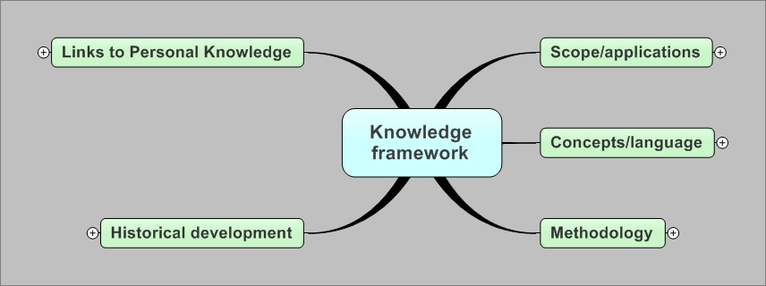
The Knowledge Framework
Generic
Applies to all AOK
Identifies Aspects to Investigate
Does not Imply Order of Presentation

Slide 4


Strongly Recommended Approach
Use of framework is not mandated—there is no way for examiners to verify use of the framework.
The model represents best practice advice for effectively addressing AOK in the TOK Classroom.
Provides structure for systematic investigation.
Will help provide students with the ability to demonstrate good understanding of content.
Objective is the ability to compare and contrast the AOK to each other.
HOWEVER

Slide 5
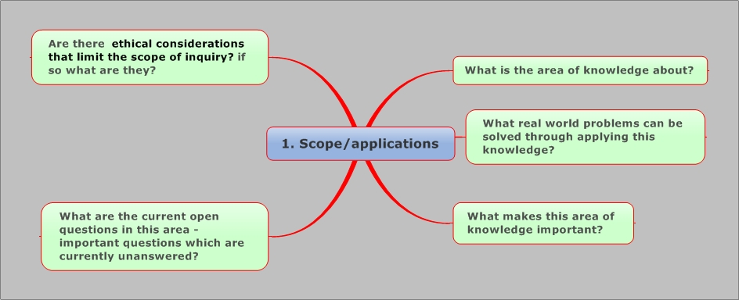

Slide 6
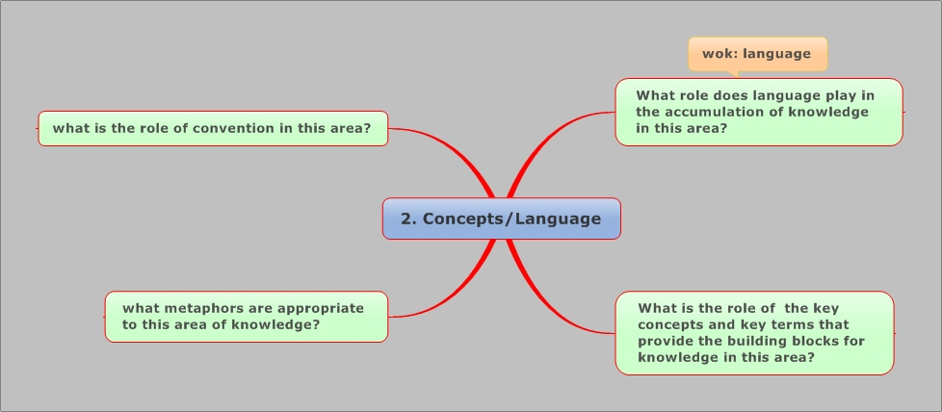

Slide 7
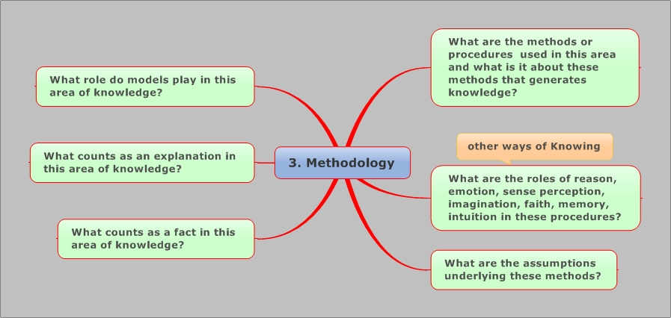

Slide 8
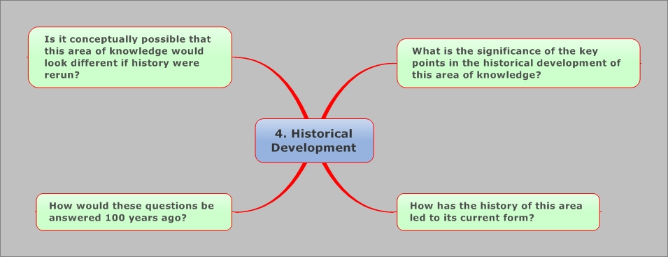

Slide 9
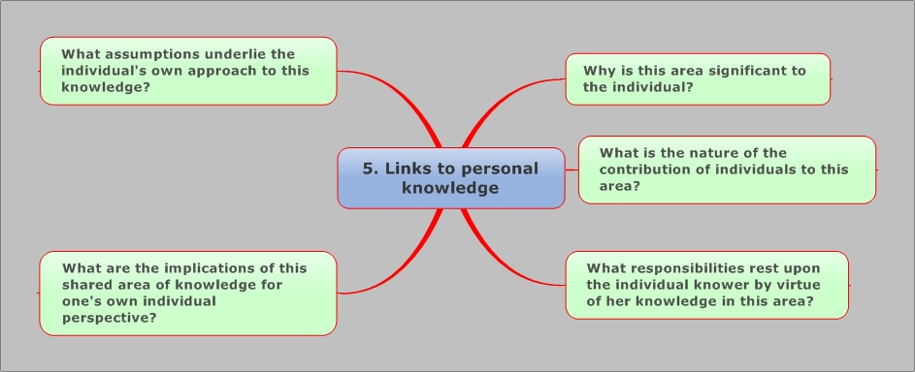

Slide 10

Additional Assistance
Three additional diagrams for EACH Area of Knowledge

Slide 11
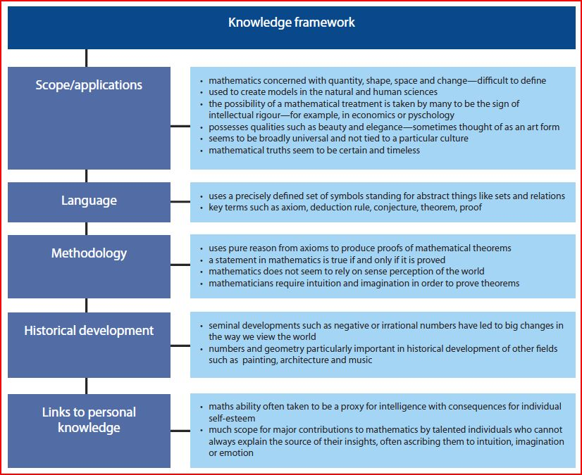
Examples for each Framework Aspect

Slide 12
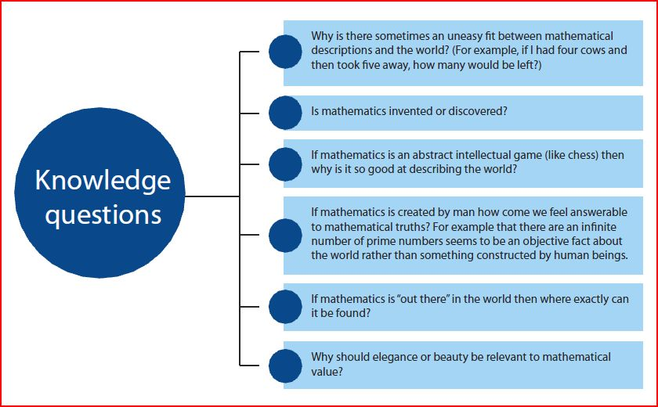
Possible Knowledge Questions

Slide 13
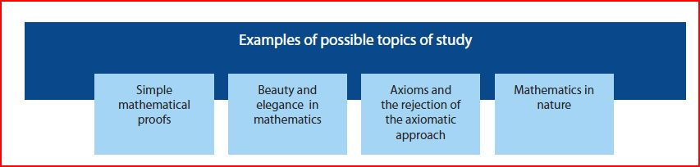
Examples for Topics of Study
These diagrams contain suggestions only! Teachers can choose what works for them.

Slide 14
Adapting the Knowledge Framework
The Knowledge framework is intended to be a tool not a straightjacket.
The five main elements (and the detailed questions) will have more or less relevance depending on the area of knowledge under consideration.
It is perfectly reasonable that the coverage of the five elements is uneven. The next slides show how this might be…

Slide 15
Knowledge framework applied to Ethics

Slide 16
Knowledge framework applied to the Arts

Slide 17
Knowledge framework applied to the Natural Sciences

Slide 18
Knowledge framework applied to Religious Knowledge

Slide 19
Knowledge framework applied to Indigenous Knowledge

Slide 20
Knowledge Framework Template
Scope/Applications
Concepts and Language
Methodology

Slide 21
Knowledge Framework Template
Historical Development
Links to Personal Knowledge

