Slide 1
4th Amendment
The right of the people to be secure in their persons, houses, papers, and effects, against unreasonable searches and seizures, shall not be violated, and no warrants shall issue, but upon probable cause, supported by oath or affirmation, and particularly describing the place to be searched, and the persons or things to be seized.

Slide 3
PATRIOT Act (2001)
FREEDOM Act (2015)
Passed 45 days after 9/11
Roving wiretaps
Delayed notification of search warrants
Expanded access to records held by third parties (doctors, libraries, websites)
No bulk collection of phone/internet data, but gov’t can request “two hops” of call records with it has “reasonable” suspicion
More transparency for # of requests
Extends many PATRIOT powers until December 2019

Slide 4
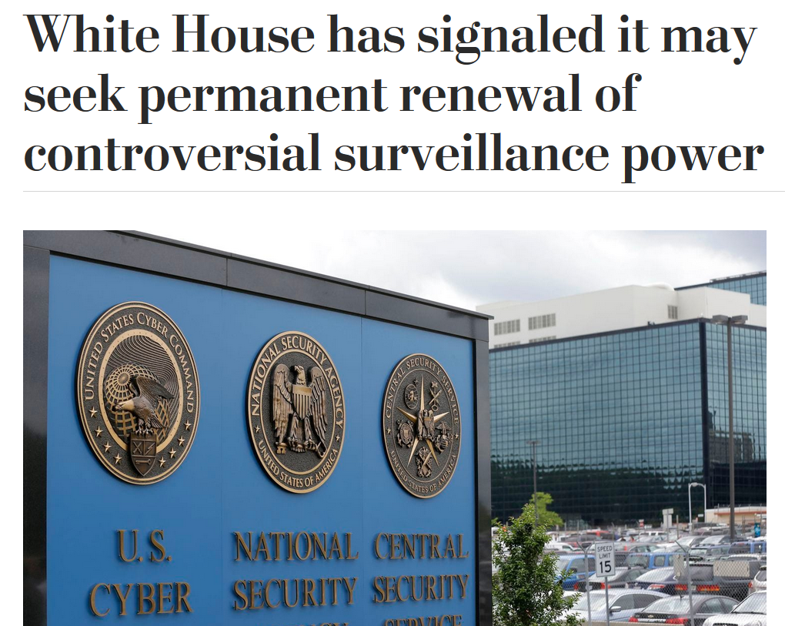
May 2019: Trump Administration is reportedly seeking to reauthorize the PATRIOT Act indefinitely, and increase NSA powers, esp. r/g phone calls.
Notes:
Set to INCREASE NSA powers, esp. r/g phone calls. OR Senator Ron Wyden is strong opponent.
https://www.washingtonpost.com/world/national-security/white-house-has-signaled-it-may-seek-permanent-renewal-of-controversial-surveillance-power/2019/04/30/b4407af2-67a5-11e9-8985-4cf30147bdca_story.html?utm_term=.22bf3331b8db

Slide 5
Is this legal?
A friend’s cousin is arrested for stealing the security badge of a TSA employee. Can the government obtain and search your call records?
Notes:
Yes, under the Freedom Act, the gov’t can request “two hops” of call records for an individual they believe is linked to terrorism.

Slide 6
Is this legal?
You attended a meeting of an activist group that police “reasonably” suspect has ties to terrorism. Can the government legally search your car and seize your possessions before informing you?

Slide 8
Do you think the PATRIOT Act violates your rights?
How much (if any) privacy are you willing to give up in the name of security?

Slide 9
Mass Surveillance
In 2017, the NSA collected 534 million phone and text records (over triple of 2016).
On average, U.S. citizens are on camera 75 times every day.
NSA bulk collects location data from phones for “target development” and unknown associates
Even if you have no links to terrorism, you are under constant surveillance.
Notes:
https://www.washingtonpost.com/apps/g/page/world/how-the-nsa-is-tracking-people-right-now/634/

Slide 10
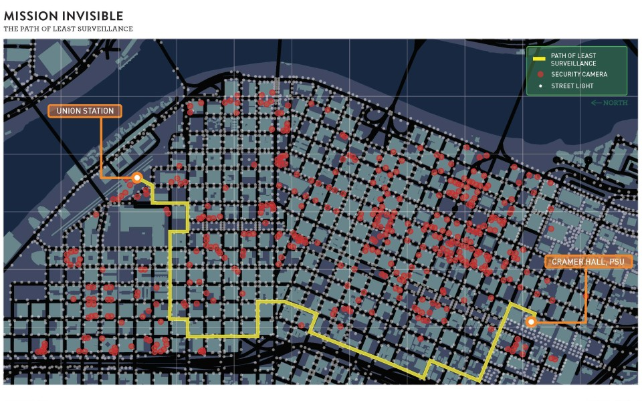

Slide 12
“...the more observant and involved individuals are in their daily lives...If we watch and report suspicious activity, we reduce the areas where criminals feel comfortable committing crimes”
Notes:
https://www.oregon.gov/oem/hazardsprep/Pages/See-Something-Say-Something.aspx

Slide 13
Suspicious Activity Reports
After 9/11, Nationwide Suspicious Activity Reporting Initiative (NSI) was created to encourage reporting on the local level
Definitions of suspicious activity vary

Slide 14
What other information would help you make a decision?
Does this qualify as suspicious behaviour according to your definition? Why?

Slide 15
What other information would help you make a decision?
Does this qualify as suspicious behaviour? Why?

Slide 16
What other information would help you make a decision?
Does this qualify as suspicious behaviour? Why?

Slide 17
Has the War on Terror made the U.S. safer?

Slide 18
Are We Safer?

