Slide 2
Using the knowledge framework to examine the arts

Slide 3
Some statements about the arts – do you agree?
The arts are for entertainment only – they cannot be considered knowledge.
The arts are purely the product of human creativity and imagination – they do not tell us anything about the world.
Knowledge is a type of belief – there are no beliefs in the arts therefore they are not knowledge
Knowing how to do something is not real knowledge – so the ability to produce art is not real knowledge.
The purpose of a work of art is to express the emotions of its author.
There is no reason in the arts they act purely on the emotions

Slide 4
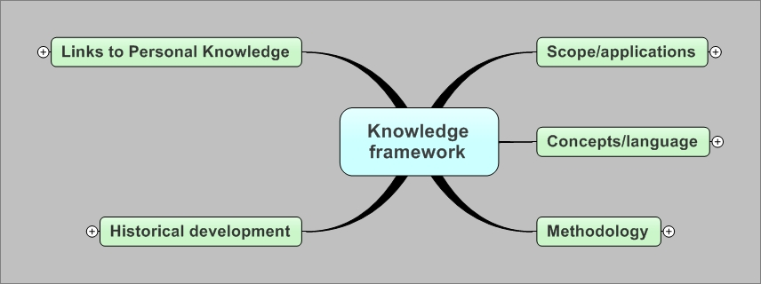
The Knowledge framework

Slide 5
The exhibition
Choose two contrasting works from the exhibition. Write notes on each of these works guided by the following questions
What makes these works effective?
How do these works refer to existing artworks?
How do these works represent reality?
How direct is the representation of reality? (is it literal or metaphorical)
What problems are solved by these artworks?

Slide 6
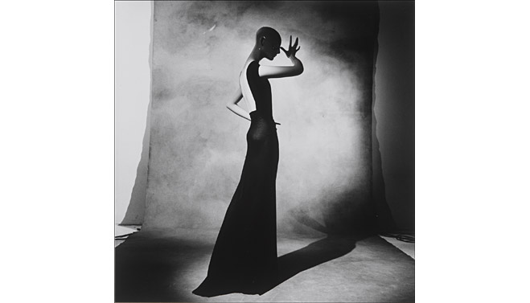
What problems are solved by the arts?

Slide 7
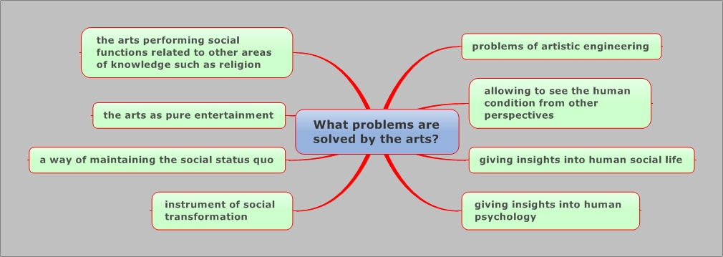
Some answers to this question

Slide 8
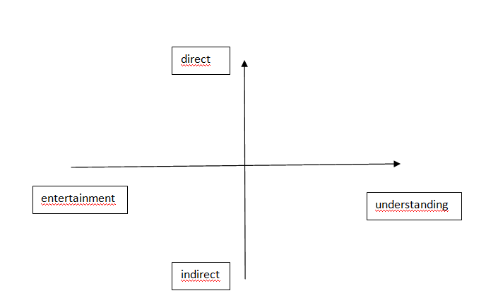
Purpose of the arts
Locate the two artworks from the exhibition on the following diagram

Slide 9
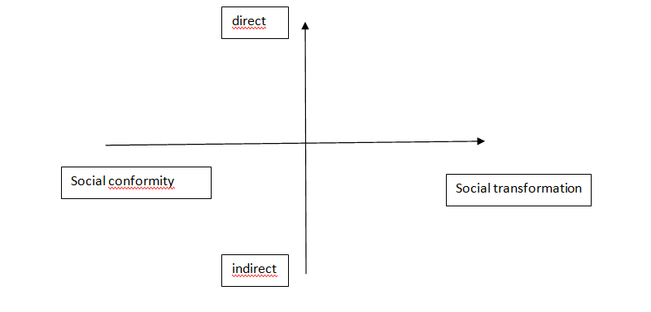
The arts and social transformation

Slide 10
The role of language and convention in the arts
Describe the role of language in your two chosen items from the exhibition.
What do we mean by convention in the arts?

Slide 11
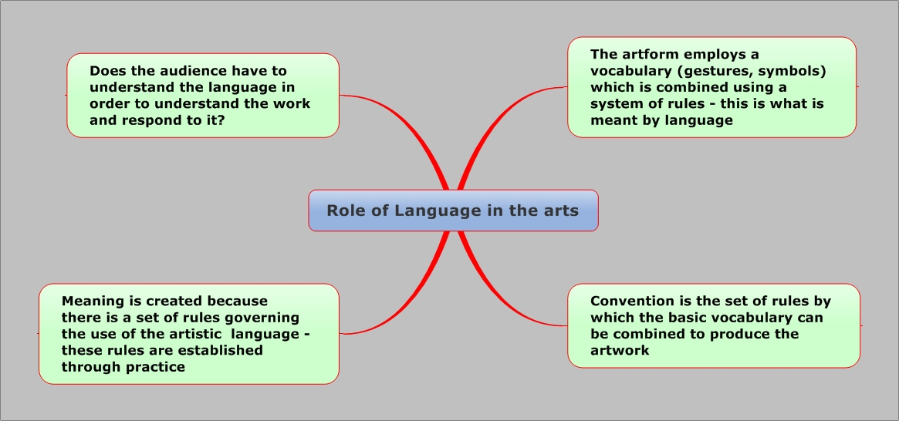
Some possible answers to the question

Slide 12
Methodology
In what sense is the production of a work of art an ’engineering project’?
What practical problems have to be solved by this ’engineering project’?

Slide 13
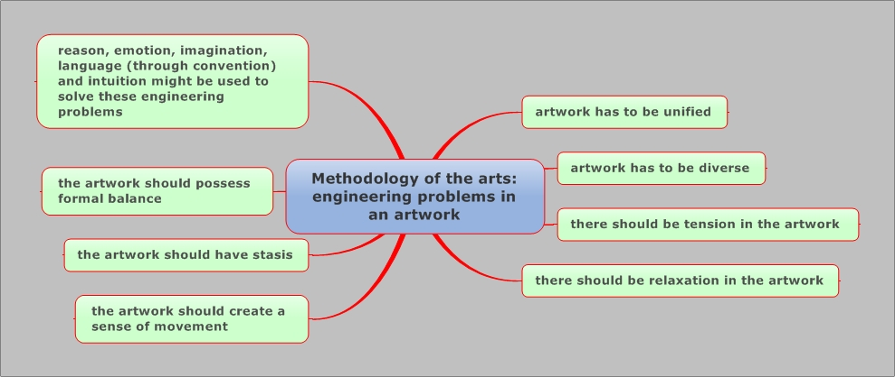
Some possible answers to the question

Slide 14
Emotion, Reason, Intuition and Imagination and the solution to the engineering problems of an artwork
What might it mean to say that emotion is the lingua franca of the arts?
To what extent can artistic activity be described as the use of imagination within a framework of reason?
To what extent does this description apply to other areas of knowledge?

Slide 15
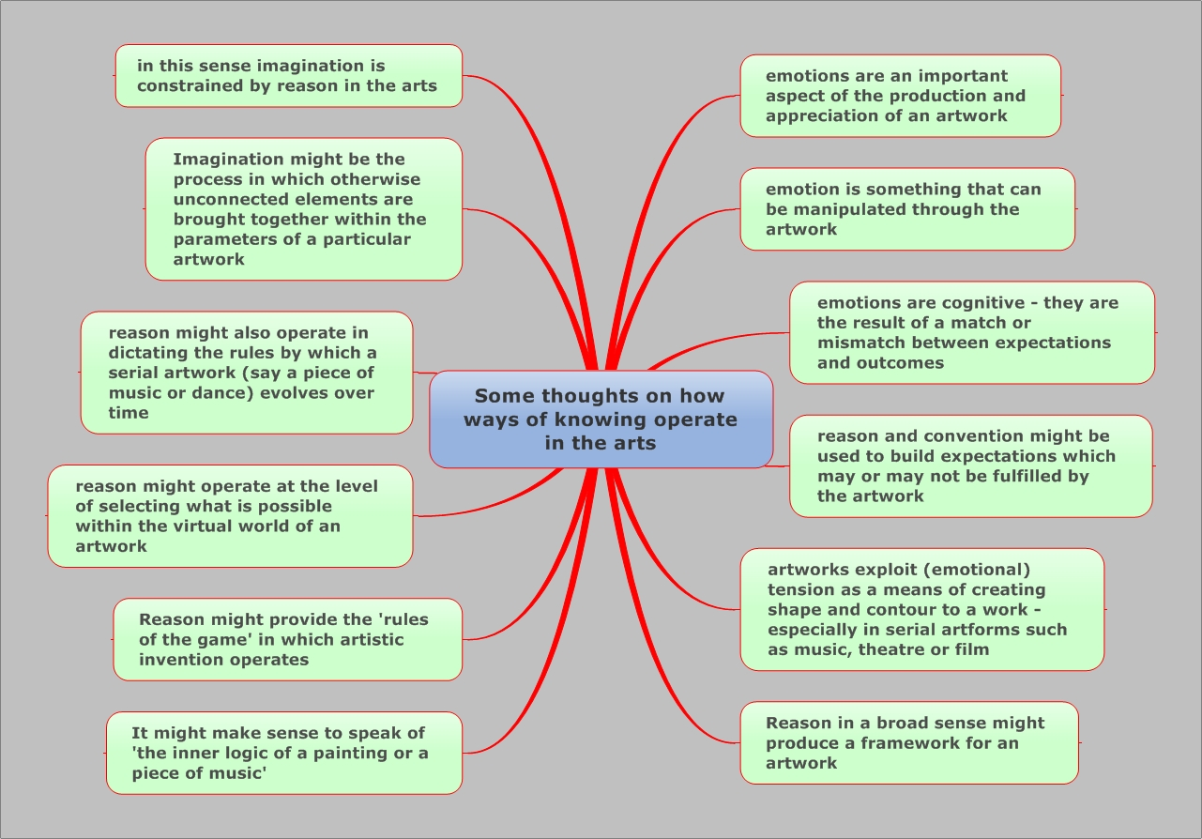
Some thoughts on woks and the arts

Slide 16
History and the arts
How do the artworks relate to history?

Slide 17
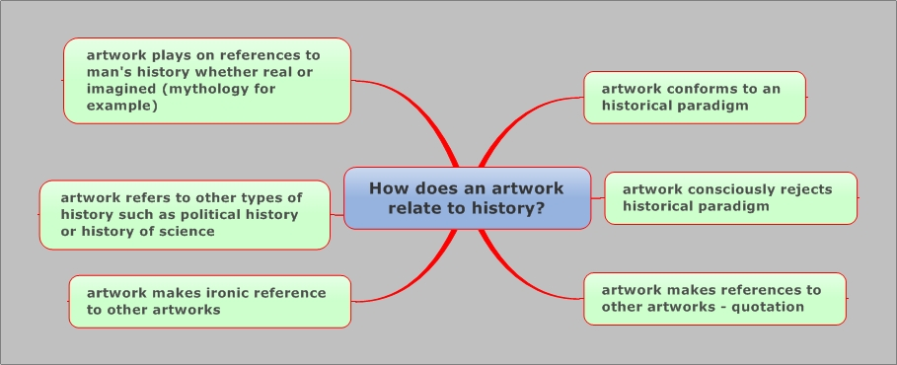
Some possible answers

Slide 18
Links to personal Knowledge
With reference to a work in the exhibition how does the shared area of knowledge that is the arts contribute to your personal knowledge?

Slide 19
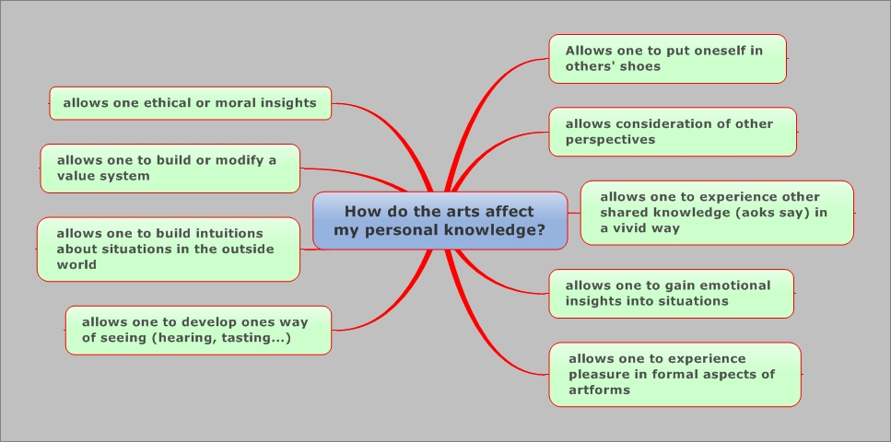
Some possible answers

Slide 20
Conclusions
The arts can be considered an area of knowledge
The arts solve problems concerning man’s relation to the world, the structure of society, creation of values and ethics.
Language and convention are crucial in the arts
Artworks have to solve a number of ’engineering problems’
Woks such as intuition, reason, imagination and emotion help to solve these engineering problems
Artworks have meaning relative to an historical horizon
Art can lead us to personal knowledge in a number of areas including knowledge of self.

