Slide 1
Am I going to be ready to graduate on time?
TuHS Graduation Requirements and General Course-Related info for Colleges & Universities

Slide 2
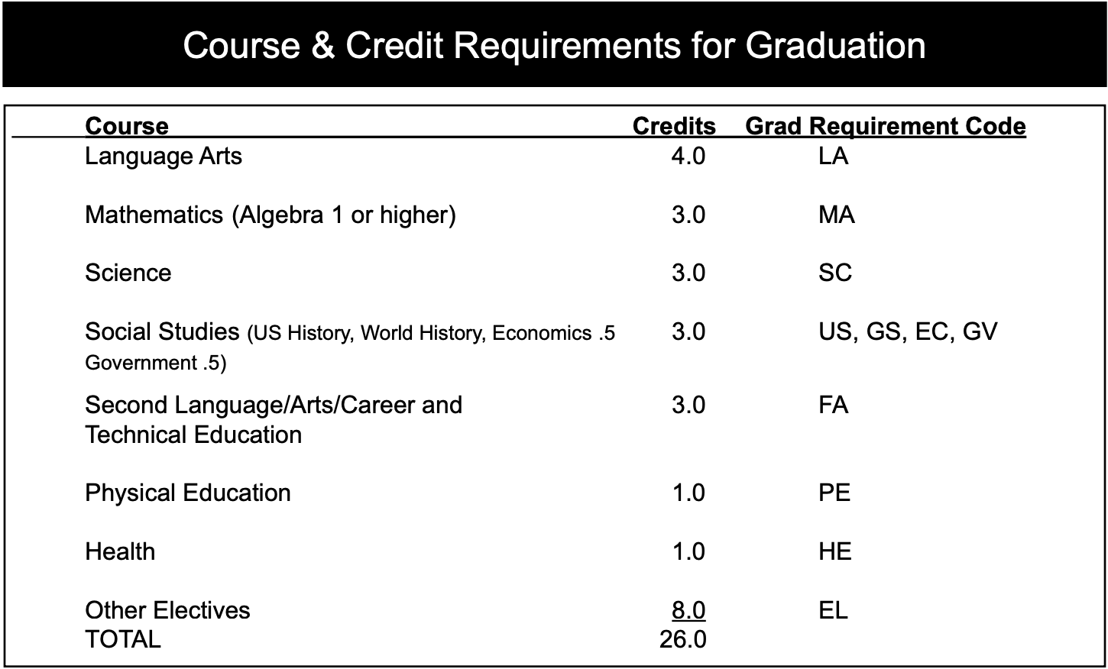
What does it take to graduate tuhs?
These are the bare-minimum graduation requirements.
Compare to your transcript and make sure you have enough of every kind of class or are planning to take them next year.
Keep in mind, this does not take into account your GPA or the requirements of individual colleges, universities, or trade programs.

Slide 3
Things to keep in mind:
Watch your GPA and grades in individual classes, as sometimes colleges and universities set requirements that are different than those of the state and TuHS.
Community colleges may have different requirements than state colleges, and private universities often have some of the most demanding requirements.
If your grades aren’t where you would like them to be and may not get you into the college you want right away, consider spending some time at a community college and then transferring to the university of your choice.
Some classes may count for graduation here (technically, you passed) but will not count towards admission to colleges.

