Slide 1
Otto von Bismarck and German Unification
The basics of German Unification

Slide 2
Context and Key Players
•Otto von Bismarck – a leader from Prussia who succeeding in unifying German-speaking states under Prussian rule
•chancellor – the highest official of a monarch
•Realpolitik – realistic politics based on the needs of the state
•annex – to take control of, usually referring to land
•Kaiser – emperor- Wilhelm I, Frederik III and Wilhelm II
•Reich – German word meaning empire or nation

Slide 3
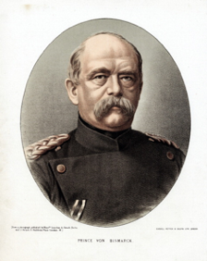
Otto von Bismarck
•He became prime minister in 1862 and then rose to chancellor.
•Bismarck was determined to unite Germany under Prussian rule.
•Rather than diplomacy, he favored a policy of “blood and iron.”

Slide 4
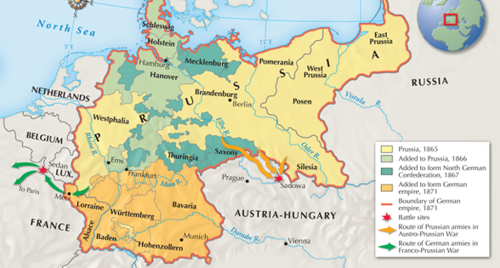
What did he want?

Slide 6
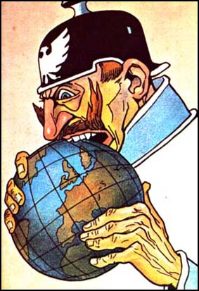
What Bismarck Achieved and What Came Next
United Germany (under Prussian authority) into a new German Empire under Kaiser Wilhelm I.
As the “Iron Chancellor”, he uses his new power to drive German industry and centralize federal control over the different states from Berlin.
Chancellor Bismarck calls the Berlin Conference in 1900 to help German expand its empire to colonies in Africa and Asia. This led to a “Scramble for Africa” and increased tensions with the established imperial powers of Europe (U.K., France, and Russia)
Under Wilhelm I, Bismarck largely controlled domestic and foreign affairs, until he was removed by the young Kaiser Wilhelm II in 1890, at the age of seventy-five.
Once Bismarck was forced to step down, German foreign policy switched from Realpolitik to Weltpolitik- the aim was to transform Germany into a global power. This change in policy accelerated the conflicts that would lead to World War I

