Slide 1
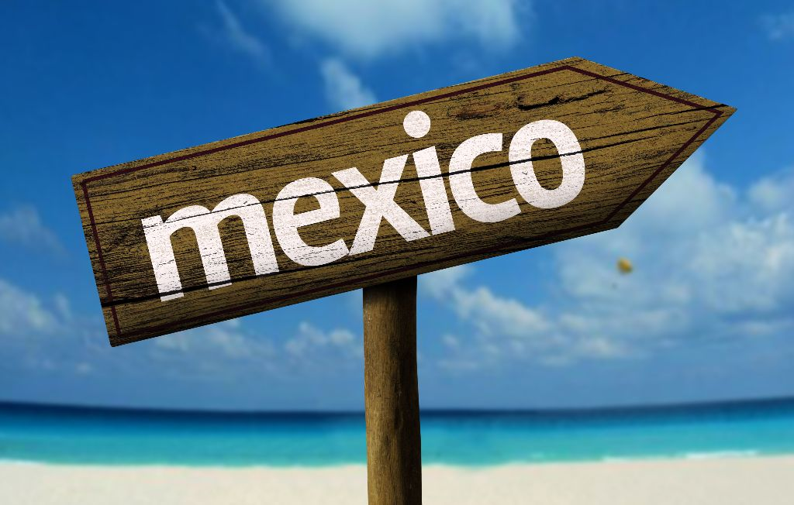
Mexico Historical Skills Assessment Review

Slide 2
Part 1: Identifications
Identifications are a short paragraph that explains what a term is and why it is significant to the topic of study.
Identifications test both your content knowledge and your critical thinking.

Slide 3
Example
Hernan Cortes was a Spanish Conquistador who conquered the Aztec Empire in 1521. He became the governor of New Spain after winning the territory for the Spanish crown. Cortes was politically and economically significant to the history of Mexico because he was responsible for establishing the Mexico as a colony of Spain. He was socially significant because he had a son with a native woman. This set the scene for racial and cultural integration that shaped modern Mexico.

Slide 4
Terms to Study
El Grito de Dolores
Mexican Revolution
La Casta
Hacienda System
Constitution of 1917
La Reforma
NAFTA
Conquistador

Slide 5
Part 2: Cause and Effect
This skill ask you to identify key causes and effects of major historical events.
You want try to discuss at least two causes and two effects of each event, all linked to the SPICE elements of Mexico.

Slide 6
Events to Study
Spain’s Conquest of Mexico
Mexican Independence
Mexico’s Signing NAFTA

Slide 7
Sample Cause and Effect
Mexican Revolution
One of the major causes of the Mexican Revolution was the long term social and economic inequality between the social classes. The long term social impact of La Casta and the economic impact of the Hacienda system left the vast majority of Mexicans without political voice, landless and without a chance for social mobility. A second cause in the short term problems was the rule of Porfirio Diaz, whose policies favored land ownership only for the elites and foreign investors. He also used violence to suppress worker strikes. These later became the rallying cries for the revolutionary groups, the Villistas and the Zapatistas.
The first major political consequence of the Mexican Revolution was the the creation of the modern Mexican nation with the adoption of the Constitution of 1917. A second economic consequence was that the new government began the process of land redistribution to increase land ownership amongst the lower classes of Mexico.

Slide 8
Part 3: Change and Continuity
In this skill you are evaluating historical change over time. You are going to be asked to evaluate two themes in Mexican History (think SPICE elements) that have changed as Mexico has modernized and what two themes have remained the same.
In what ways has Mexico changed and stayed the same from the Plan de Iguala to Today?

