Slide 1
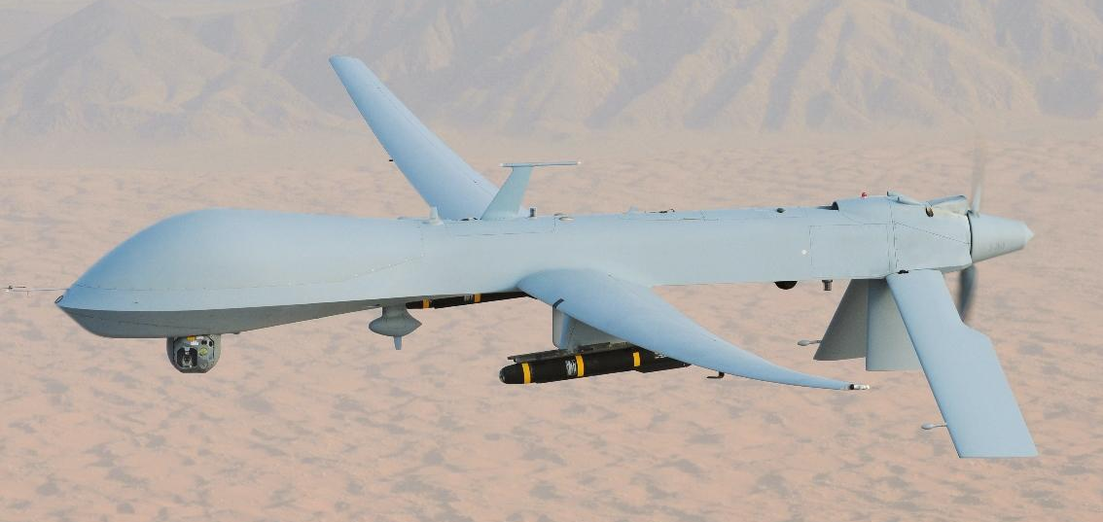
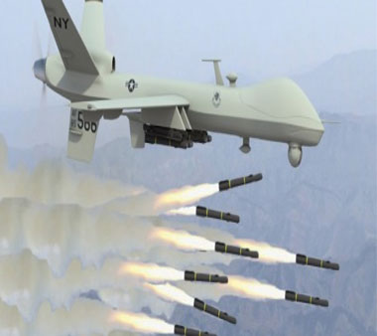
Drones
UAVs (unmanned aerial vehicles)
Unmanned combat aerial vehicle
RPAs/RPV (remotely piloted aircraft/vehicle)
Targeted killings/signature strikes
Airstrikes

Slide 3
Choices Drone Videos

