Slide 1
Day 2: The Creation of a Nation
I can explain the events that led to Mexico gaining its independence and development into a constitutional republic .
I can define Conservative and Liberal.

Slide 2
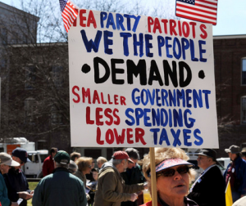
Conservative
Someone who wants the political, social & economic systems of their country to either A) remain the way they are OR B) return to how they were at an earlier time.

Slide 3
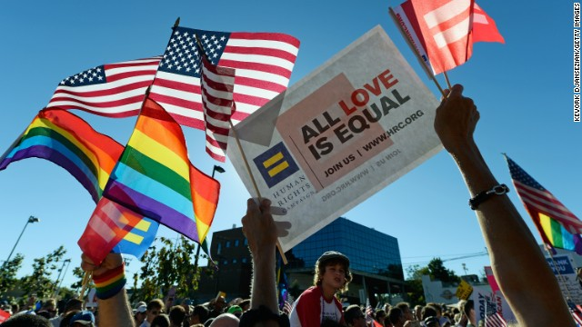
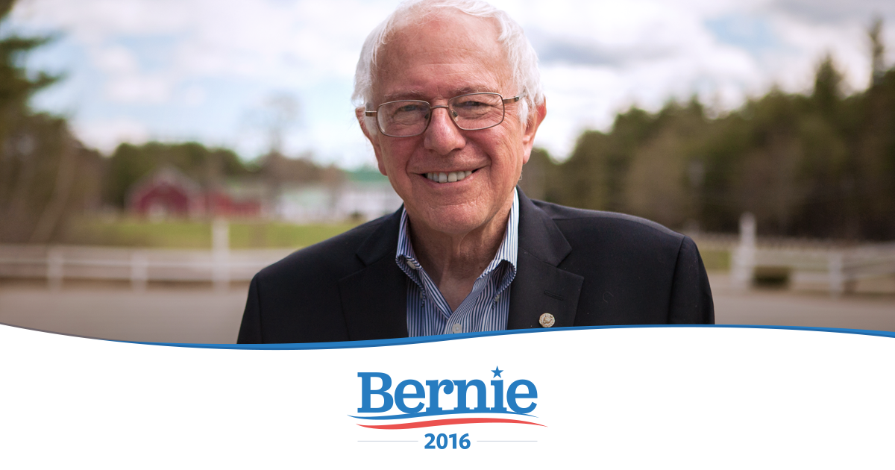
Liberal
Someone who wants the political, social & economic systems of their country to change.

Slide 4
Independence to Revolution
The story of how Mexico became Mexico
Working in pairs you are going to create a graphic novel/screenplay that explains how Mexico freed itself from Spanish control and because a modern republic in 1917.
Details of the assignment are available on the class website

Slide 5
Events in Europe
Spain was conquered by France in 1808 and the Spanish King was arrested.
Spanish Monarchy recap
Spain created a new constitution that called for popular voting rights and a representative government. They also called for more revenue from New Spain.
This heightened tensions between the Creoles and Peninsulares.
Mestizo citizens were struggling and also upset.

Slide 6
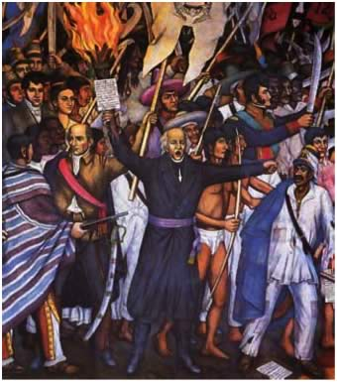
El Grito de Dolores
“The Cry of Dolores”: September 16, 1810
Father Miguel Hidalgo, a creole priest, called for Independence and managed to gain thousands of followers.
EL Grito de Dolores

Slide 7
El Grito de Dolores
Hidalgo and his followers were upset about the Peninsulares were exploiting them to pay the higher taxes demanded by Spain and the continuation of slavery in New Spain
They used violence to make their claims but in the end their movement was crushed and Hidalgo and the other leaders were executed
Others took the helm of the rebellion, including José María Morelos y Pavón, Mariano Matamoros and Vicente Guerrero,
The Cry of Dolores - Re-Enactment

Slide 8
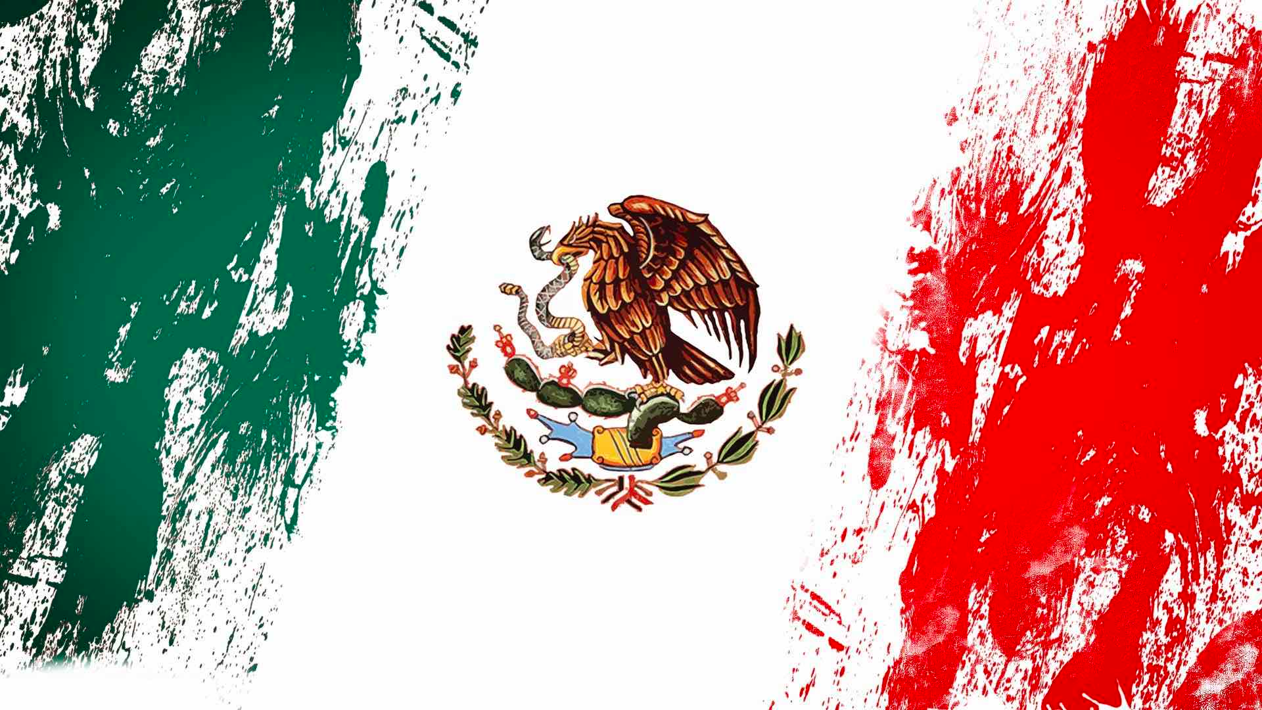
Independence
In 1814, the Spanish King returned to power, only to be forced to sign a new Liberal constitution in 1820 because of a popular uprising.
In 1821, Conservative Peninsulares and Creoles who feared that they would lose their legal privileges in Mexico, called for independence.
After a short war against Spain, Mexico gained its independence.

Slide 9
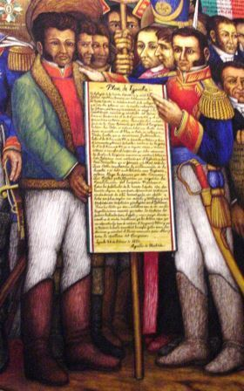
El Plan De Iguala
Mexico signed the Plan de Iguala (The Three Guarantees)
Religion: Roman Catholic Church as the State Religion
Social Equality: Creoles get the same rights as Peninsulares
Independence: Constitutional Monarchy with a European Ruler

Slide 10
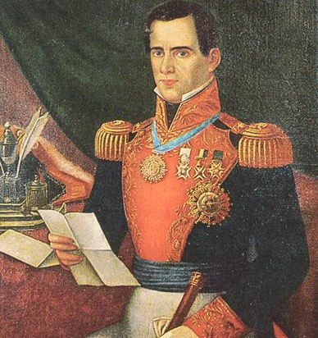
After Independence
Many Peninsulares left Mexico.
Infrastructure was destroyed during the war.
Mexico lacked roads and bridges and struggled to build any because they could not collect taxes.
The Presidency was a revolving door of rich landowners who controlled their own armies.
Instability throughout the country.
Little impact on the lives of the Mestizos…Still lacked rights and economic opportunities.

Slide 11
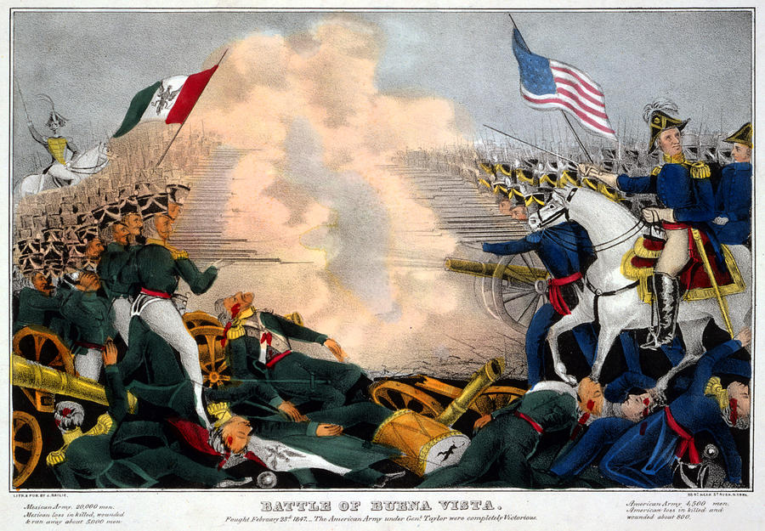
The War of North American Intervention
Antonio Lopez Santa Ana was President of 11 different Governments
Kept Central Government Weak and Taxes Low
United States saw opportunity and expanded into Mexico’s Territory North of the Rio Grande (Arizona, Texas, New Mexico)
Mexican - American War in 3 Minutes!

Slide 12
Loss of Land and Pride

Slide 13
Conservative and Liberal
Antonio Lopez Santa Ana
Bentio Juarez

Slide 14
Liberals & Conservatives
Liberals
Conservatives
In Mexico in the 19th century (1800s), liberals were mainly educated, middle class professionals like teachers, & lawyers who lived in cities or urban areas.
Liberals generally wanted to distribute the ownership of land more broadly & to change the political & economic systems of Mexico to give every Mexican more political rights & power rather than the systems being dominated by an elite few.
In Mexico in the 19th century (1800s), conservatives were mainly wealthy landowners, Creoles, who wanted a political system that would preserve their wealth & privilege.
Conservatives generally did NOT want to share land in Mexico with mestizo or indigenous Mexicans.

Slide 15
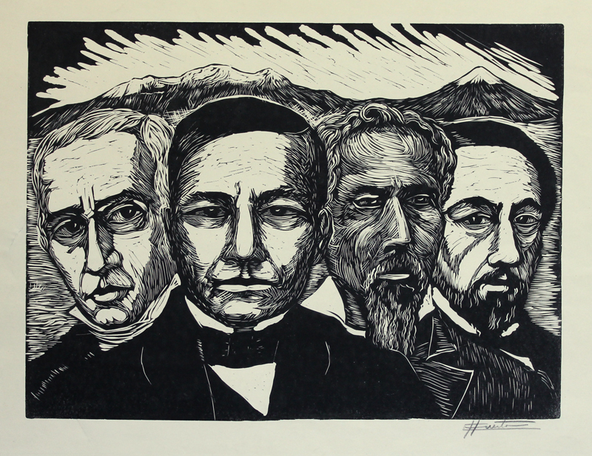
Rise of the Liberals: La Reforma
La Reforma: A Liberal group who called for the lessening of the power of the Catholic Church and Military Leaders in Mexico.
La Reforma forced the Church to sell non-religious land holdings and established a new constitution.
Benito Juarez: Mestizo Lawyer who rose to power from nothing.

Slide 16
Juarez as President
Juarez wrote the Constitution of 1857
Created a government run Education System.
Limited the Power of the Catholic Church. Forced them to sell much of their land.
Broke up Tribal Lands into Individually Owned Lands→ Didn’t Work because Rich landowners bought them instead.
Encouraged foreign investment to build infrastructure.
Juarez died in 1872 of a heart attack

Slide 17
Civil War and Cinco de Mayo
1858 conservative elites forced the liberals out of Mexico because they were afraid of losing their social and economic privileges
The liberals, led by Juarez, fled to Veracruz and civil war broke out.
During the war, Mexico quit paying its foreign loan payments and the French sent an army to invade and bring the conservatives back to power. On May 5th 1862, the liberal forces defeated the French invaders in the Battle of Puebla.
The French eventually withdrew in 1867 and Juarez was once again elected as President
Franco-Mexican War in 3 Minutes

Slide 18
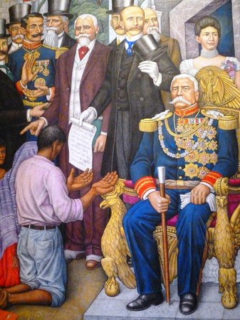
Diaz’s Rule
Porfirio Diaz in History (USE SUBTITLES IN ENGLISH!)
Porfirio Diaz rose to power (through a coup) as President following Juarez’s death and stayed in power for over 30 years. During his rule…
The Rich continued to buy land…
30 families owned half of Mexico by 1900 → More Poverty
Mexico engaged in foreign trade → More Foreigners…90% of all industry and 25% of land owned by foreigners.
Oil and Coal were discovered → Controlled by Foreigners
Pan, o Palo (Bread or Stick): Created a large police force to maintain his rule (stick) and rewarded his supporters with benefits (bread).

Slide 19
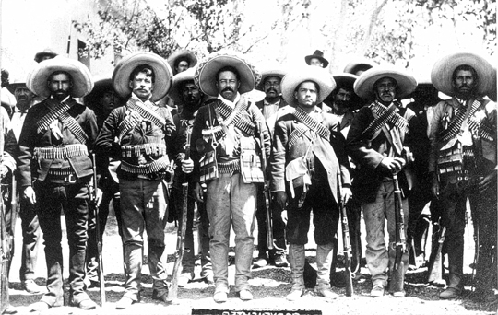
Mexican Revolution
A major armed struggle between 1910-1920 that reshaped Mexican Social, Political, Environmental, Cultural, and Economic landscape.
Main goal was to end Diaz’s 30 year rule and to solve inequality within society.
A variety of factions rose up to fight against Diaz’s government.

Slide 20
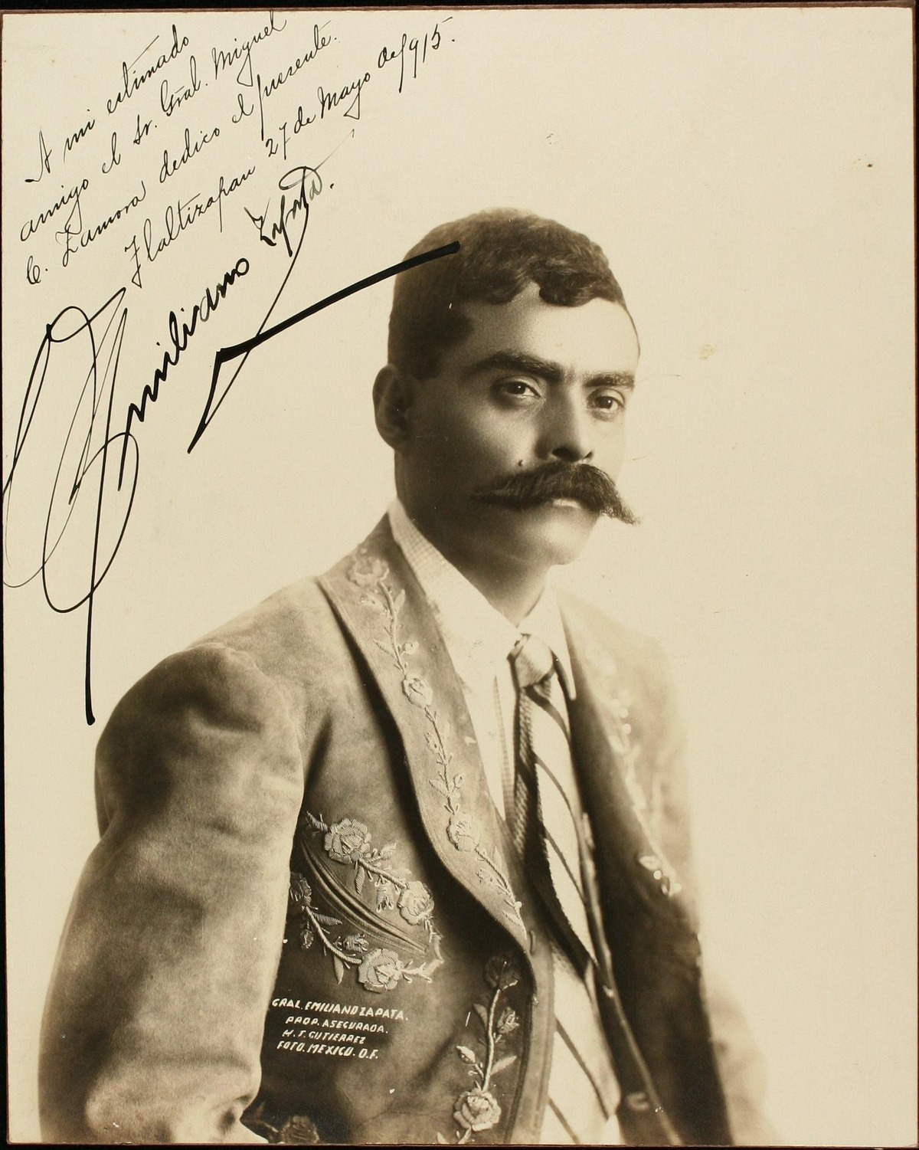
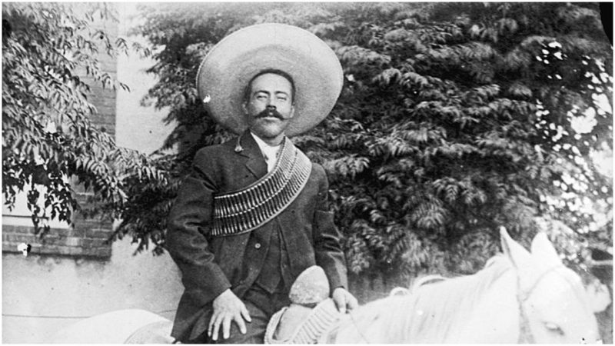
Factions of The Revolution
Zapatistas (Southern Mexico)
Led by Emiliano Zapata
Called for land reform and redistribution of Hacienda Land to the peasants.
Villistas (Northern Mexico)
Led by Pancho Villa
Called for land reforms and improved working conditions for rural peasants and urban workers.
Constitutionalists
Called for democracy established by the 1857 constitution
Supported by the United States

Slide 21
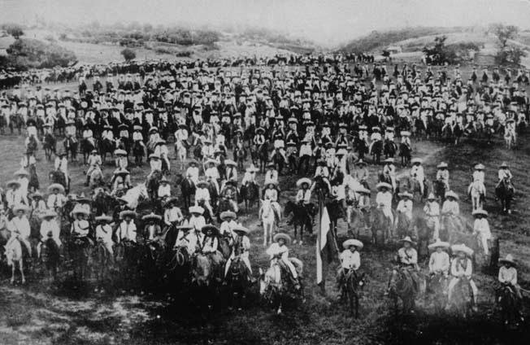
The Mexican Revolution
1912-1914: The various rebel armies fought battles all around Mexico against the national Army.
Leaders such as Zapata and Villa rose to international fame.
1914: The Constitutionalists (with help from the U.S.) took power of the presidency.
Arranged a meeting between then three factions to bring peace to Mexico.
The meeting broke into violence between the major armies and led to a continued struggle.

Slide 22
A Continuing Struggle
Villa & Zapata made an alliance to overthrow the Constitutional Government and fighting increased.
Villa: “Those are men who have always slept on soft pillows. How could they ever be friends of the people who have spent their whole lives in nothing but suffering?”
The Villa-Zapata army was crushed after attempting to occupy Mexico City and the Constitutionalist took control of the country.
Mexican Revolution during WW1 (Watch first five minutes)

Slide 23
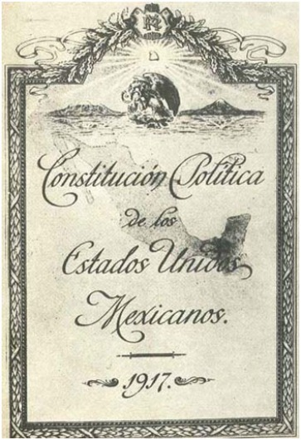
The Constitution of 1917
The Constitutionalist Government crafted a the 1917 Constitution.
The Constitution Increased the role of the Mexican Government in the lives of Mexicans with policies such as…
Redistributed land to rural farmers
Allowed for the creation of Labor Unions
Took control of oil and mineral deposits
Created a separation of Church & State

Slide 24
Results of the Mexican Revolution
While not all accepted the Constitution, it did mark the end of the Revolution.
Diaz’s Government ended
The Hacienda System Ended
Kicked out Foreign Investors and the Mexican Government took control of the Oil Business.
Increased Nationalism among Mexicans.
Eventual Rise of the PRI (Held power from 1930’s to 1990’s).
Between 1.5-2 Million Mexicans died during these conflicts and much of the Mexican infrastructure was destroyed.

