Slide 1
Geography Assessment #2 China
Practice Activity

Slide 2
Instructions
This PPT is set up to help us practice interpreting and applying different forms of geographic data.
Each example will give you a few tips and then ask you to draw conclusions from the source.
The next slide will give you a few possible conclusions that you could have drawn but they are not exhaustive.

Slide 3
Annotated Maps
Tips for Success
Look for a title to learn the purpose of the map
Find the key to understand symbols and scale
Use the units provided to give as much specific evidence as possible to support your conclusions

Slide 4
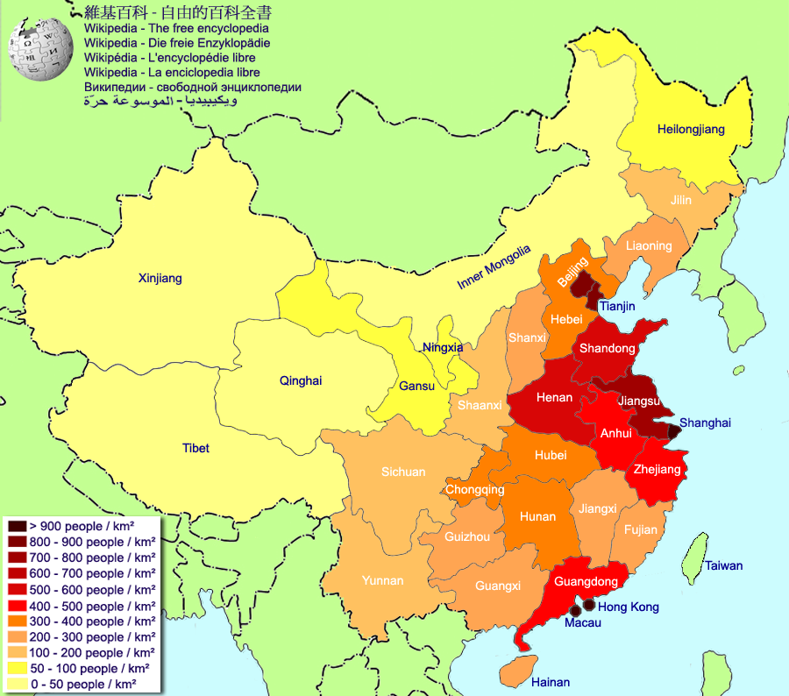
Annotated Maps
China’s Population Density 2010
Practice Questions
What cities and provinces of China are most densely populated?
What is the population density of Sichuan province?
Based on what you know about China, how might you explain its population distribution?

Slide 5
Annotated Maps
Answers
1. Cities: Beijing, Shanghai, Tianjin, Hong Kong, Macau
Provinces: Shandong, Henan, Anhui, Jiangsu, Guangdong
200-300 people per square kilometer
3. The population density in the eastern/south eastern areas of China can be explained by the arable climate, the proximity to the Yangtze and Yellow rivers and the economic development of the eastern coast.

Slide 6
Graphs
Tips for Success
Look for a title to learn the purpose of the graph
Find the key to understand symbols and scale
Use the units provided to give specific evidence as possible to support your conclusions

Slide 7
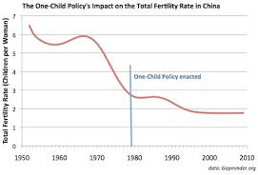
Graphs
Practice Questions
What was the Total Fertility Rate (Average number of children a woman will have in her lifetime) of China in 1978?
Over what time period did we see the most dramatic drop in TFR?
What has happened in the last 20 years to China’s TFR?

Slide 8
Graphs
Answers
1. About 3 children per woman
1965-1980 saw a dramatic drop from an average of 6 children per woman to less than 3.
In the last 20 years China’s total fertility rate has flattened out to staying steady just below two children per woman.

Slide 9
Tables
Look for a title to learn the purpose of the table
Review each unit used and make sure you understand what it is measuring
Use the units provided to give specific evidence as possible to support your conclusions

Slide 10
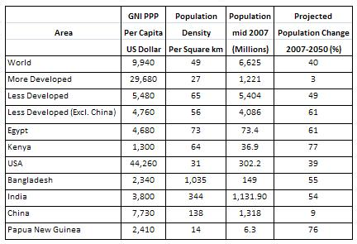
Tables
Practice Questions
What was the population density of China in 2007?
How does it compare with others countries?
Which population is expected to change the most by 2050?
Compare and Contrast the population concerns of India and China.

Slide 11
Tables
Answers
1. 138 people per square mile
2. China is relatively densely populated but it is 2 times less than India and 10 times less densely populated than Bangladesh
3. Kenya
4. Both China and India have large populations but India’s is expected to grow dramatically (54%) in the next 3 decades whereas China’s is going to grow more slowly (9%).

Slide 12
The Next Step... Multiple Inputs
If you had any trouble understanding how the answers to the questions were reached, please come see me outside of class.
Now that you have the data, we need to apply it. In the next assessment you are going to be asked to draw from multiple sources to create a developed conclusion. Remember to support all claims with specific evidence.
Use the three previous geographical resources to respond to the claim:
“China’s doesn’t have a over population problem, just a population density problem”
To what extent do you agree that China’s population concerns could be solved if they could develop the western portions of the county?

Slide 13
Sample Response
While China’s overpopulation problem will continue to put a strain on resources in the eastern part of the nation, to a larger extent its over population can be managed through urban development. Over the past 20 years, China’s TFR has stagnated and is actually below replacement of 2.1, which shows the population is stabilizing. With a predicted growth rate of only 9%, the Chinese government does not need to focus on population growth but density. In Xinjang province there are only 50-100 people per square kilometer, compared to over 900/sqkm in Shanghai. If the government could find ways to draw Chinese families to move out West, they would alleviate their density problems and continue to grow their share of the global economy.

Slide 14
Come See Me ASAP IF You Have Questions!!!

