Slide 1
Islam and Religion in the Middle East
Kahoot!

Slide 2
Basics Terms
Islam - the world’s 2nd largest religion
Muslim - someone who practices Islam
Quran (Qur'an, Koran) - the central religious text of Islam
Mosque - place of worship
Allah - the Arabic name for God, used in Islam

Slide 3
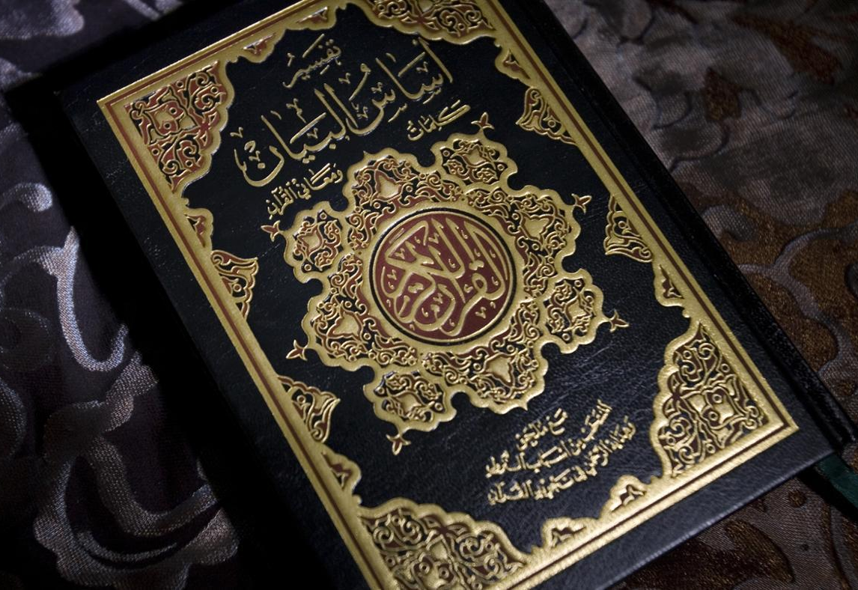
History of Islam
In 610 CE, Muhammad received divine revelations through the angel Gabriel
Acknowledged lineage of other prophets: Jesus, David, Moses, Abraham, Noah and Adam.
These revelations, over 23 years, became the Quran
Considered God’s “final revelation”

Slide 4
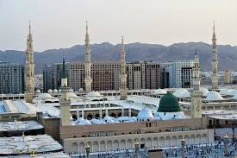
History of Islam
Muhammad gained some followers in Mecca, and fled to Medina (hijra) in 618 CE and established a Muslim community
Conquered Mecca in 629 CE
After Muhammad’s death in 632 CE, the conflict over his successor led to the Sunni-Shia Split

Slide 5
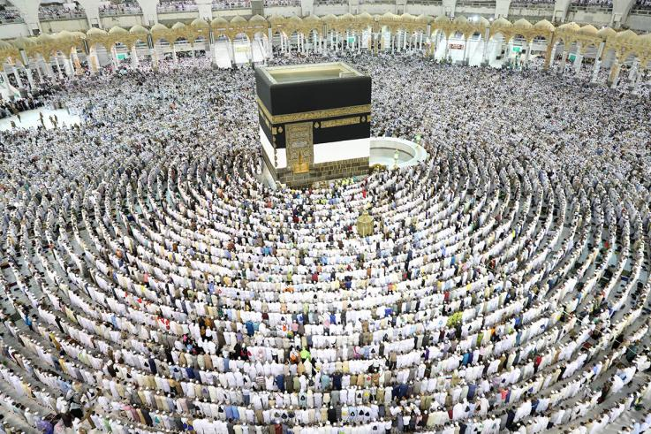
Mecca
As the site of Muhammad’s birth and early revelations, Mecca is extremely significant in Islam
All Muslims who are able must make a pilgrimage to Mecca at least once in their life (the Hajj)
During prayer, Muslims turn in the direction of Mecca

Slide 6
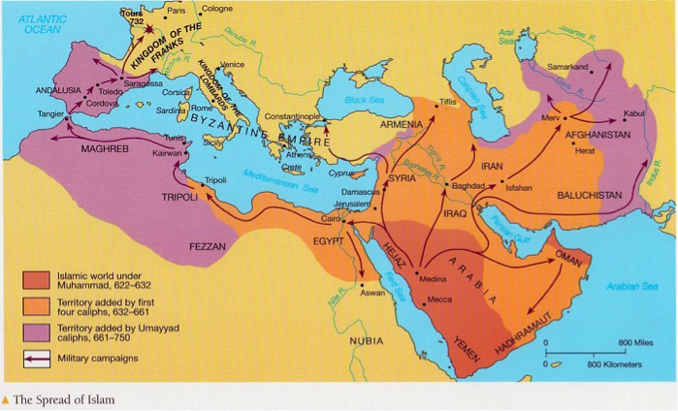

Slide 7
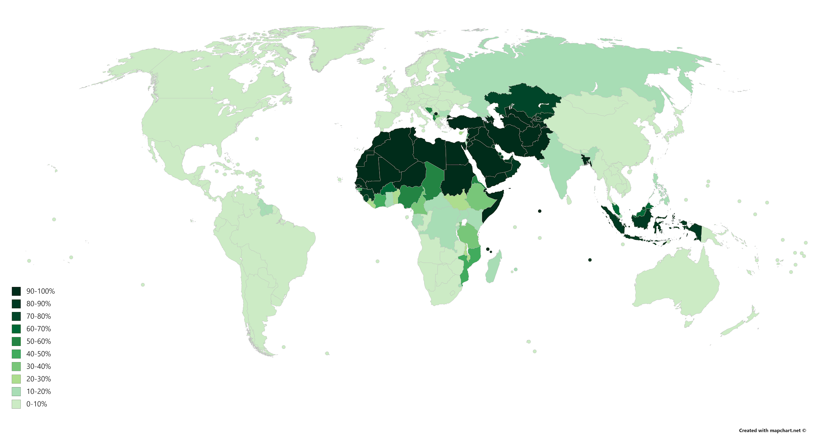

Slide 8
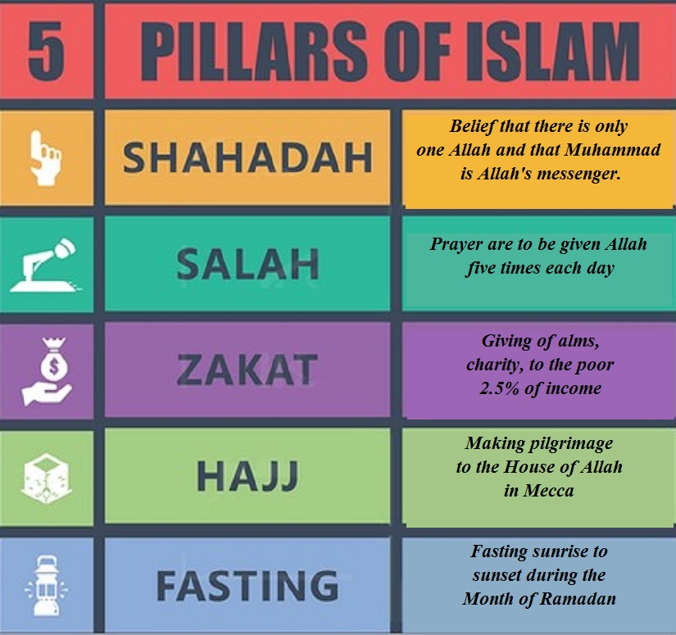
5 Pillars of Islam
Declaration of Faith
Praying 5 times a day
Giving Money to Charity
Fasting during Ramadan
Making a pilgrimage to Mecca at least once in your life

Slide 9
Declaration of Faith (Shahadah)
Accepting the belief of Allah as the only God and Muhammad as the prophet.
Recited in Arabic as: "There is no god but God (and) Muhammad is the messenger of God."
Recited to become Muslim

Slide 10
2. Prayer (Salah)
Five daily prayers at dawn, noon, afternoon, evening, and night
Need to wash or purify before prayer (wudu)
Face in the direction of Mecca
a series of set positions

Slide 11
3. Charity (Zakāt)
Responsibility for all Muslims who are able to do so, aiming to balance inequality
Customarily 2.5% (or 1/40) of total wealth (above a minimum amount)

Slide 12
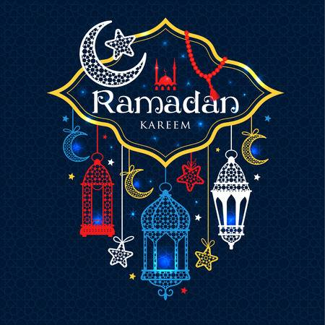
4. Fasting
During the month of Ramadan, Muslims must fast from dawn until dusk (exceptions for pregnant women, children, and medical restrictions)
Needs intention, represents atonement, closeness to God, remembering needy, and gratitude

Slide 13
5. Pilgrimage to Mecca (Hajj)
At least once in their life, able-bodied Muslims must make the pilgrimage to Mecca during the holy month (Dhu al-Hijjah), based on lunar calendar
Several rituals involved, including circling the Kaaba
Over 2 million people every year (more than 1.7 from outside Saudi Arabia)

Slide 14
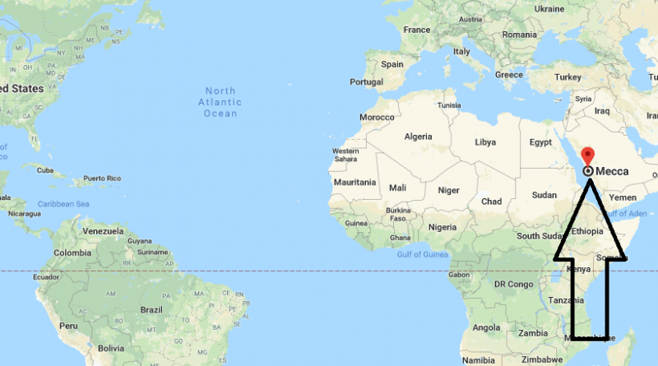

Slide 15
6 Main Beliefs of Islam
Belief in Allah as the one and only God
Belief in Angels
Belief in the holy book
Qur’an, Sunnah (practice and examples of the Prophet’s life), and Hadith (reports of what he said or approved)
Belief in the prophets
Adam, Abraham, Moses, David, Jesus, Muhammad is the last prophet
Belief in the Day of Judgement
The day when the life of every human being will be assessed to decide whether they go to heaven or hell
Belief in Predestination
Allah has the knowledge of all that will happen
Muslims believe that this doesn’t stop humans from making free choice

Slide 16
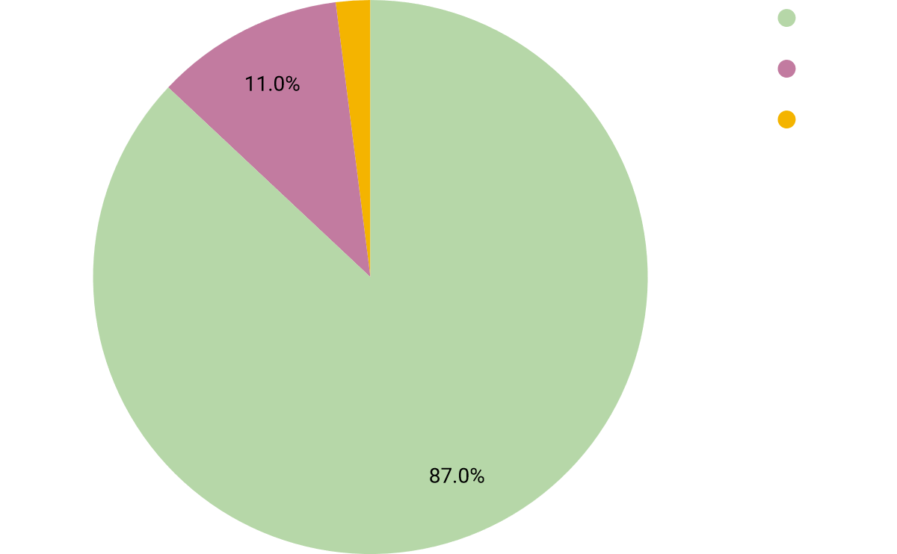
Notes:
Approximate, #s vary

Slide 18
Shared beliefs & practices
Shia and Sunni both share a great deal of Islamic core beliefs and practices:
The Prophet Muhammad was the messenger of Allah.
All must follow the teaching of Muhammad.
All must abide by the five pillars of Islam.

Slide 19
Differences in Beliefs and Practices
The Shia are typically seen as putting more emphasis on the power of God and his determination of human fate, and are often understood to be more inclusive in their definition of what it means to be a Muslim.
Focus on the individual
The Sunni tradition has placed great emphasis on the role of religion in public and political life, with great weight placed on the Shariah (Islamic law) as the standard for a broad range of social issues—marriage, divorce, inheritance, commerce, and so on.
Focus on community

Slide 20
Commonalities with Christianity
Assalaamu Álaikum - Peace be upon you
Predestination
Shared prophets (Adam, Abraham, Moses and Jesus)

Slide 21
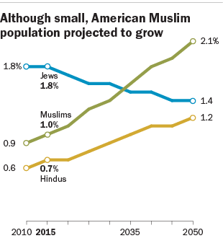
Modern Growth of Islam
Globally, Islam is expected to surpass Christianity to be the world’s largest religion by 2060
In the United States, currently around 1%, but growing quickly

