Slide 1
M.A.I.N.
Causes of World War I

Slide 2
World War I
Allied Powers
France, UK, Russia, (U.S.)
VS
Central Powers
Germany, Austria-Hungary, Ottoman Empire
1914-1918

Slide 3
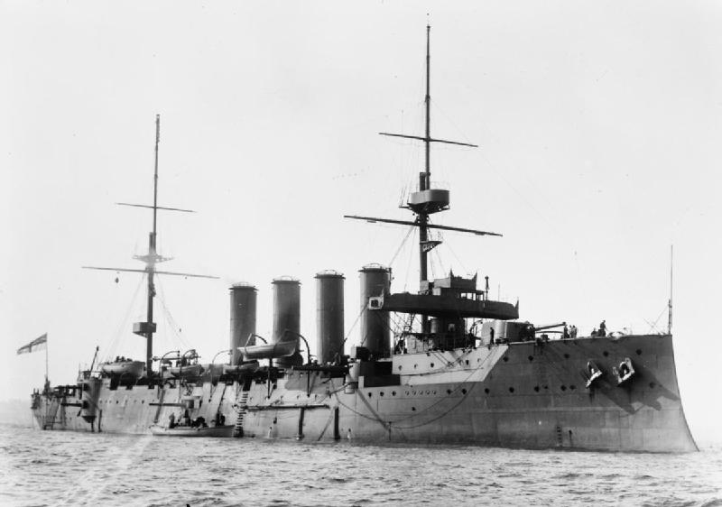
Militarism
Focus on military, building military power, arms race
Feeds culture of paranoia, belief war is good.
Example: Britain has a powerful navy, which caused Germany to build-up their navy.

Slide 4
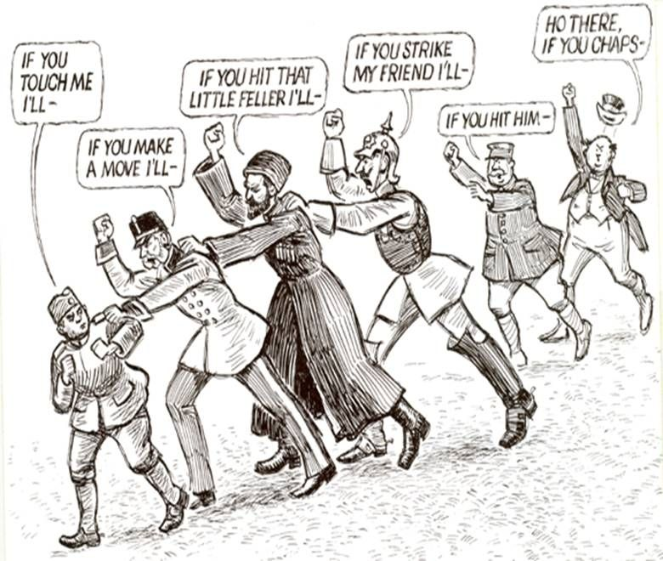
Alliances
Group of countries who have agreed to work together, often for mutual defense.
Example: Triple Entente (France, Russia, Britain) and Triple Alliance (Germany, Austria-Hungary, Italy).

Slide 5
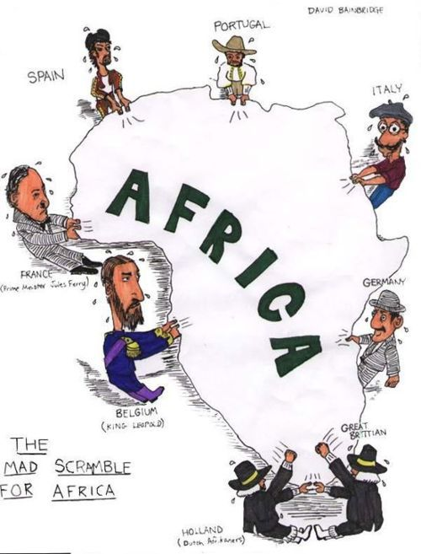
Imperialism
Larger countries establishing colonies in smaller countries to extract resources and expand their power.
Example: Competition for the best colonies and resources in the Scramble for Africa.

Slide 6
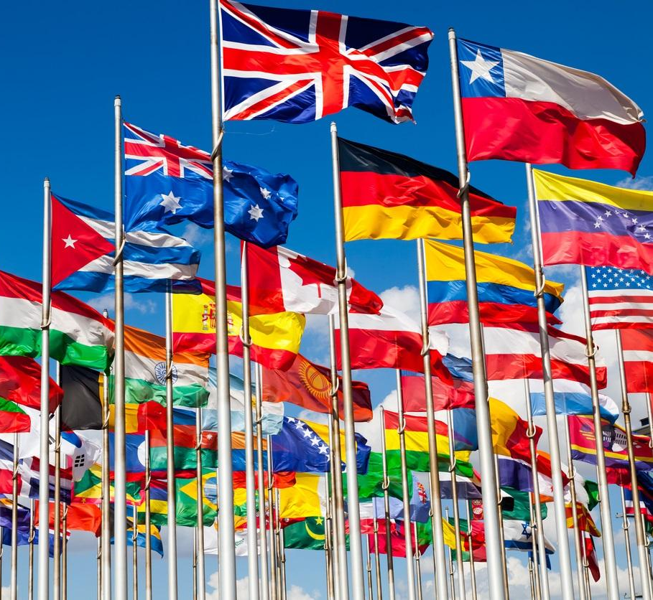
Nationalism
Extreme pride in your country/group you identify with to the point you believe your nation is superior to others.
Example: German nationalism & German Unification.

