Slide 1
Argumentative Strategies

Slide 2
Our Goal
I can understand the strategies that authors use when making a persuasive argument.
I can use these strategies to analyze and create arguments.

Slide 3
Argumentative Strategies
Whenever we try to convince someone of an idea, we use a variety of strategies to accomplish this goal.
Pathos: Emotional Appeals
Ethos: Character Appeals
Logos: Logical Appeals

Slide 4
Pathos
Emotional Appeal: Appeals to an audience’s needs, values, and emotional sensibilities.
Telling a touching story
Listening to an interview
Linking to fear (should be avoided)
Johnny had dropped out of school and was living on the street. However, when he decided to return to school and graduate, he turned his life around. Now he has a stable job and supports his family of four.

Slide 5
Ethos
Ethical appeals which are based on the character, credibility, or reliability of the writer.
Use of trustworthy and reliable sources/stats
Correctly identifying the counterclaim
Common ground with your audience
Explaining your credibility
The Oregon Bureau of Labor reports that while it is possible to find a well-paying job without a high school diploma, those who have a diploma earn on average $149 more a week.

Slide 6
Logos
Logos or the appeal to reason relies on logic or reason.
Relies on Inductive and Deductive Reasoning

Slide 7
Inductive and Deductive Reasoning
Inductive Reasoning
Takes specific representative case or facts and then draws generalizations or conclusions from them.
Example: Graduating from high school helped Johnny get a better job, so a high school diploma will allow you to find a better job.
Deductive Reasoning
Begins with a generalization and then applies it to a specific case.
Example: High School graduates make $149 more per week, so if you graduate high school, you will make $149 more a week.

Slide 8
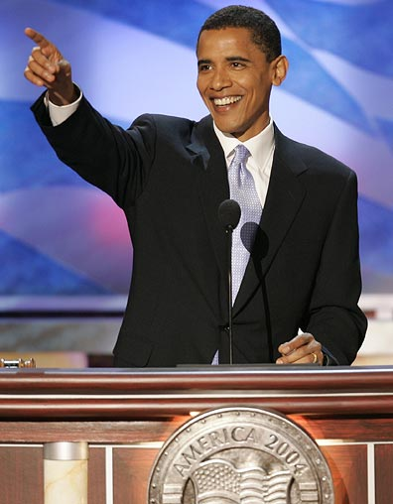
Let’s Practice
We are going to watch President Obama’s 2004 Democratic Convention speech (from before he was elected).
As we watch, attempt to identify his use of each of the three types of arguments in his speech.
Notes:
The picture should lead to the CNN version of the speech.

