Slide 1
Naviance: The Basics
(Or: Help! I haven’t logged in since Freshman year!!!)

Slide 2
How do I log in to Naviance?

Slide 3
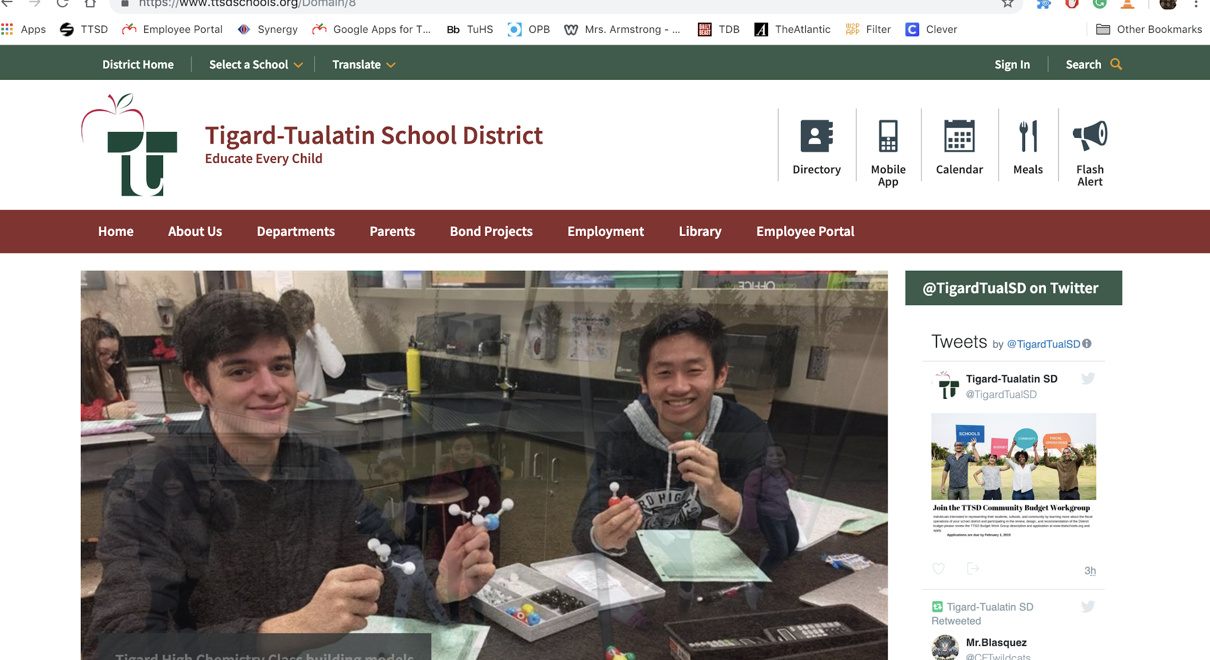
On any device with internet access, go to the TTSD homepage and select TuHS….
It’s basically at the bottom of this drop down list.

Slide 4
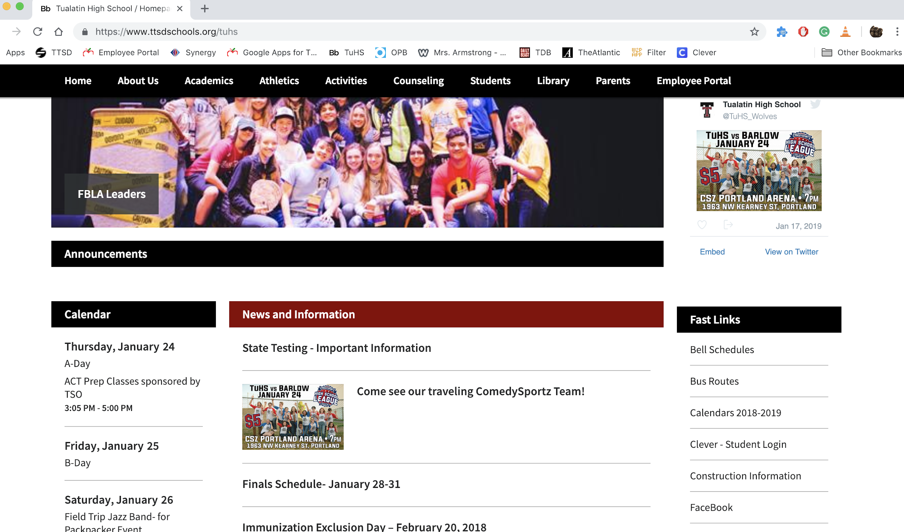
Once you are on the TuHS homepage. Click on the “Clever - Student Login” link (Clever is a password-keeper app)...

Slide 5
Click “Log in with Google” and it will either take you directly to Clever if you’re on a school device, or log in using your student gmail info

Slide 6
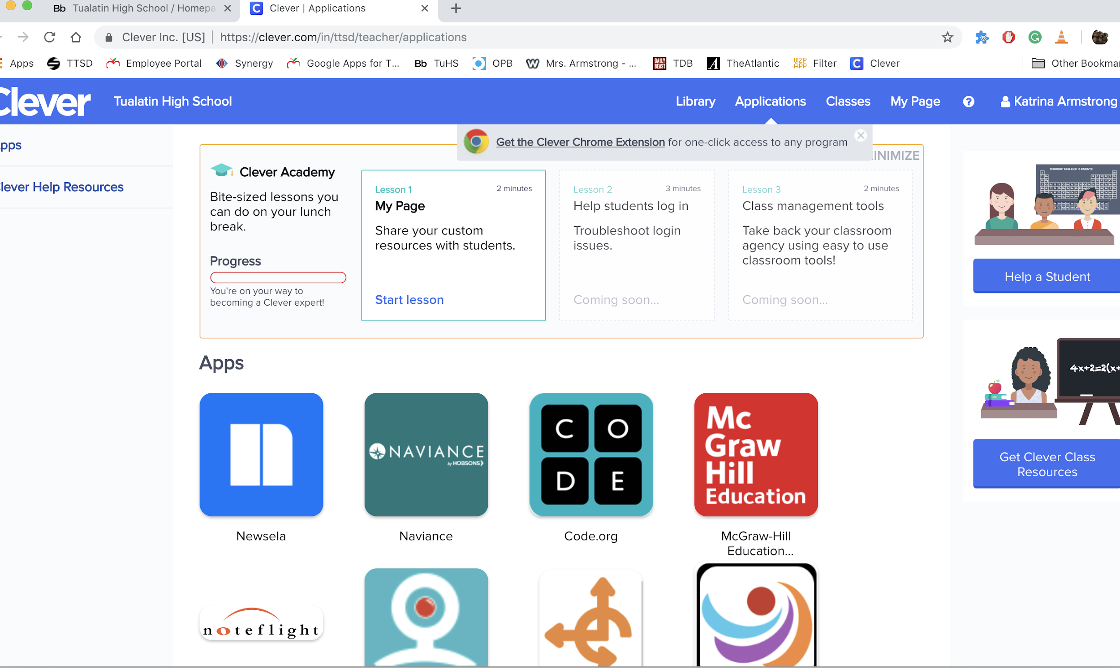
Once you get to your Clever home page, you should see something like this. Click on the link to Naviance.

Slide 7
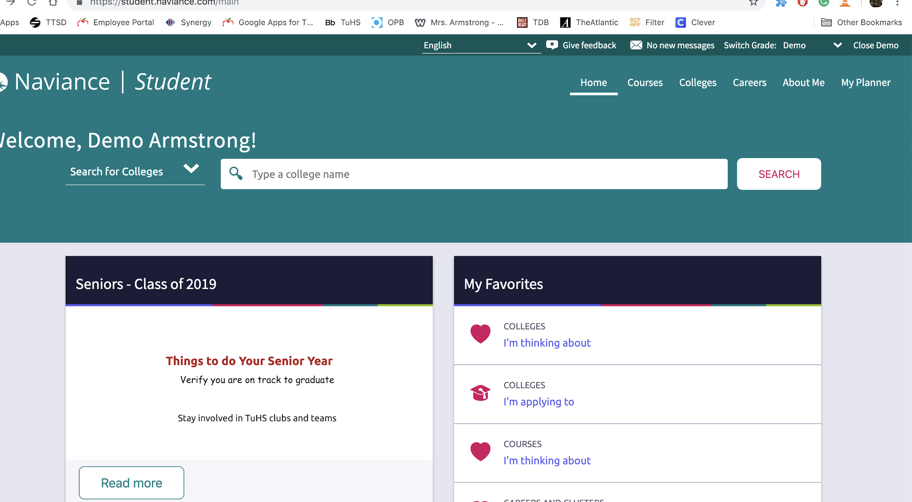
And then you’re there!

Slide 8
What can Naviance help me to do?

Slide 9
Lots of things!
Here are some tasks that Naviance can help you with:
Locating colleges
Scheduling a meeting with a visiting admissions counselor
Building a resume
Finding scholarship opportunities
Narrowing down your ideas about the future

Slide 10
Finding Colleges (when you don’t already have some in your favorites list):
Click here if you want to access Naviance’s College Matching tools or do more in-depth exploration.
Use this bar if you already have a school in mind and just want to see more info on it.
Once you have schools on your favorites list, you can find them here.

Slide 11
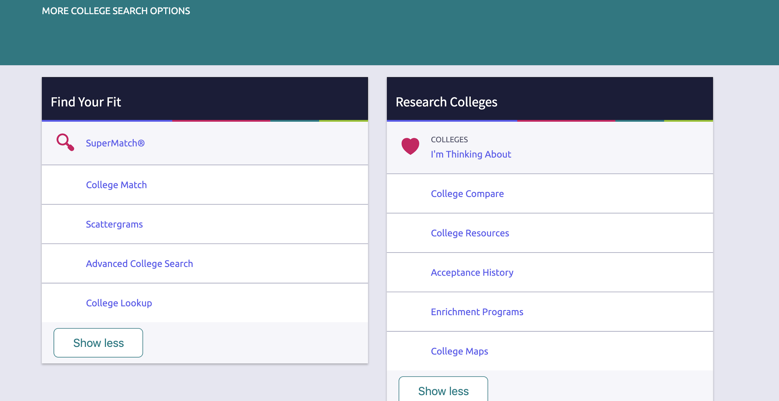
Once Naviance has more of your information, it can help match you to schools that may be a good fit based on your profile.
College Compare can help you see if your test scores are a good fit for universities you may have in mind.
The SuperMatch tool helps you find colleges based on your preferences in specific categories (location, demographics, cost, student life, etc.)

Slide 12
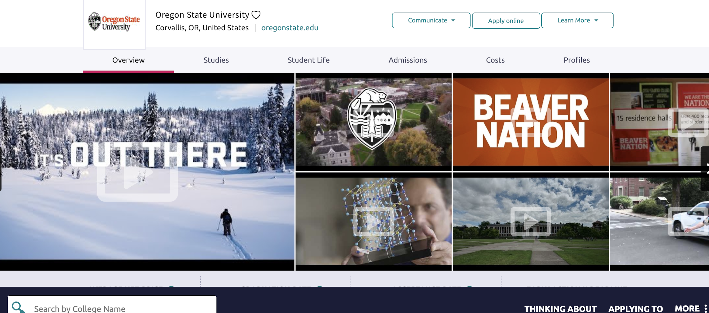
You can always click on the heart next to a college to add it to your favorites list.

Slide 13
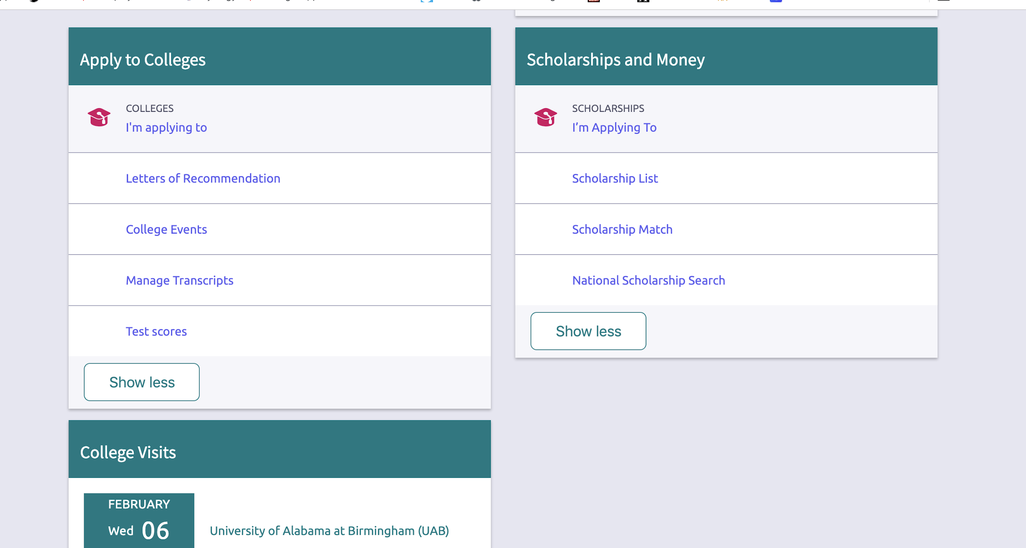
Looking for Scholarships...
There are a couple of things you can do here. There is a portal for scholarships you’ve already started (one you have reached that phase), 2 general lists of scholarships, and a matching service to help you more specifically.
Be very aware of local scholarships. Places are looking to give local students money. The pool of competition is much smaller, and ANY money helps.

Slide 14
Building a Resume
Go to the “About Me” main page.

Slide 15
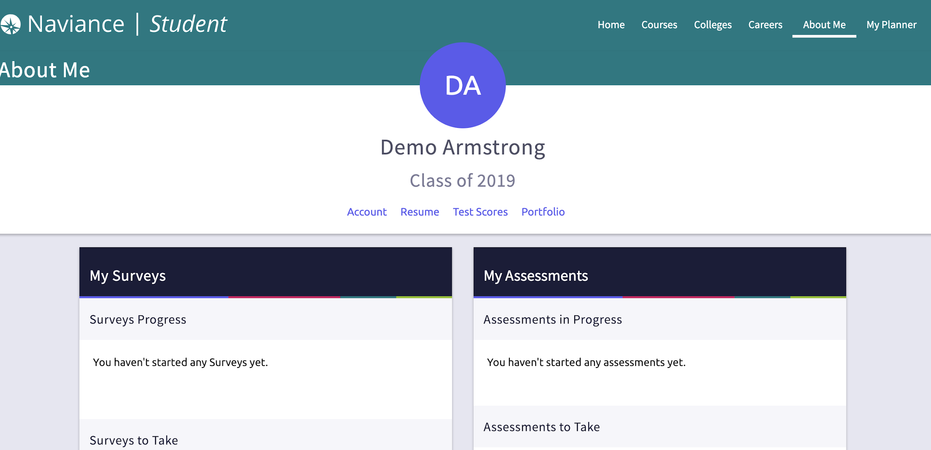
Choose the “Resume” option, and it will help walk you through creating a resume. Make sure yours is up-to-date, as you’ll probably start to need it soon (if you haven’t already).

Slide 16
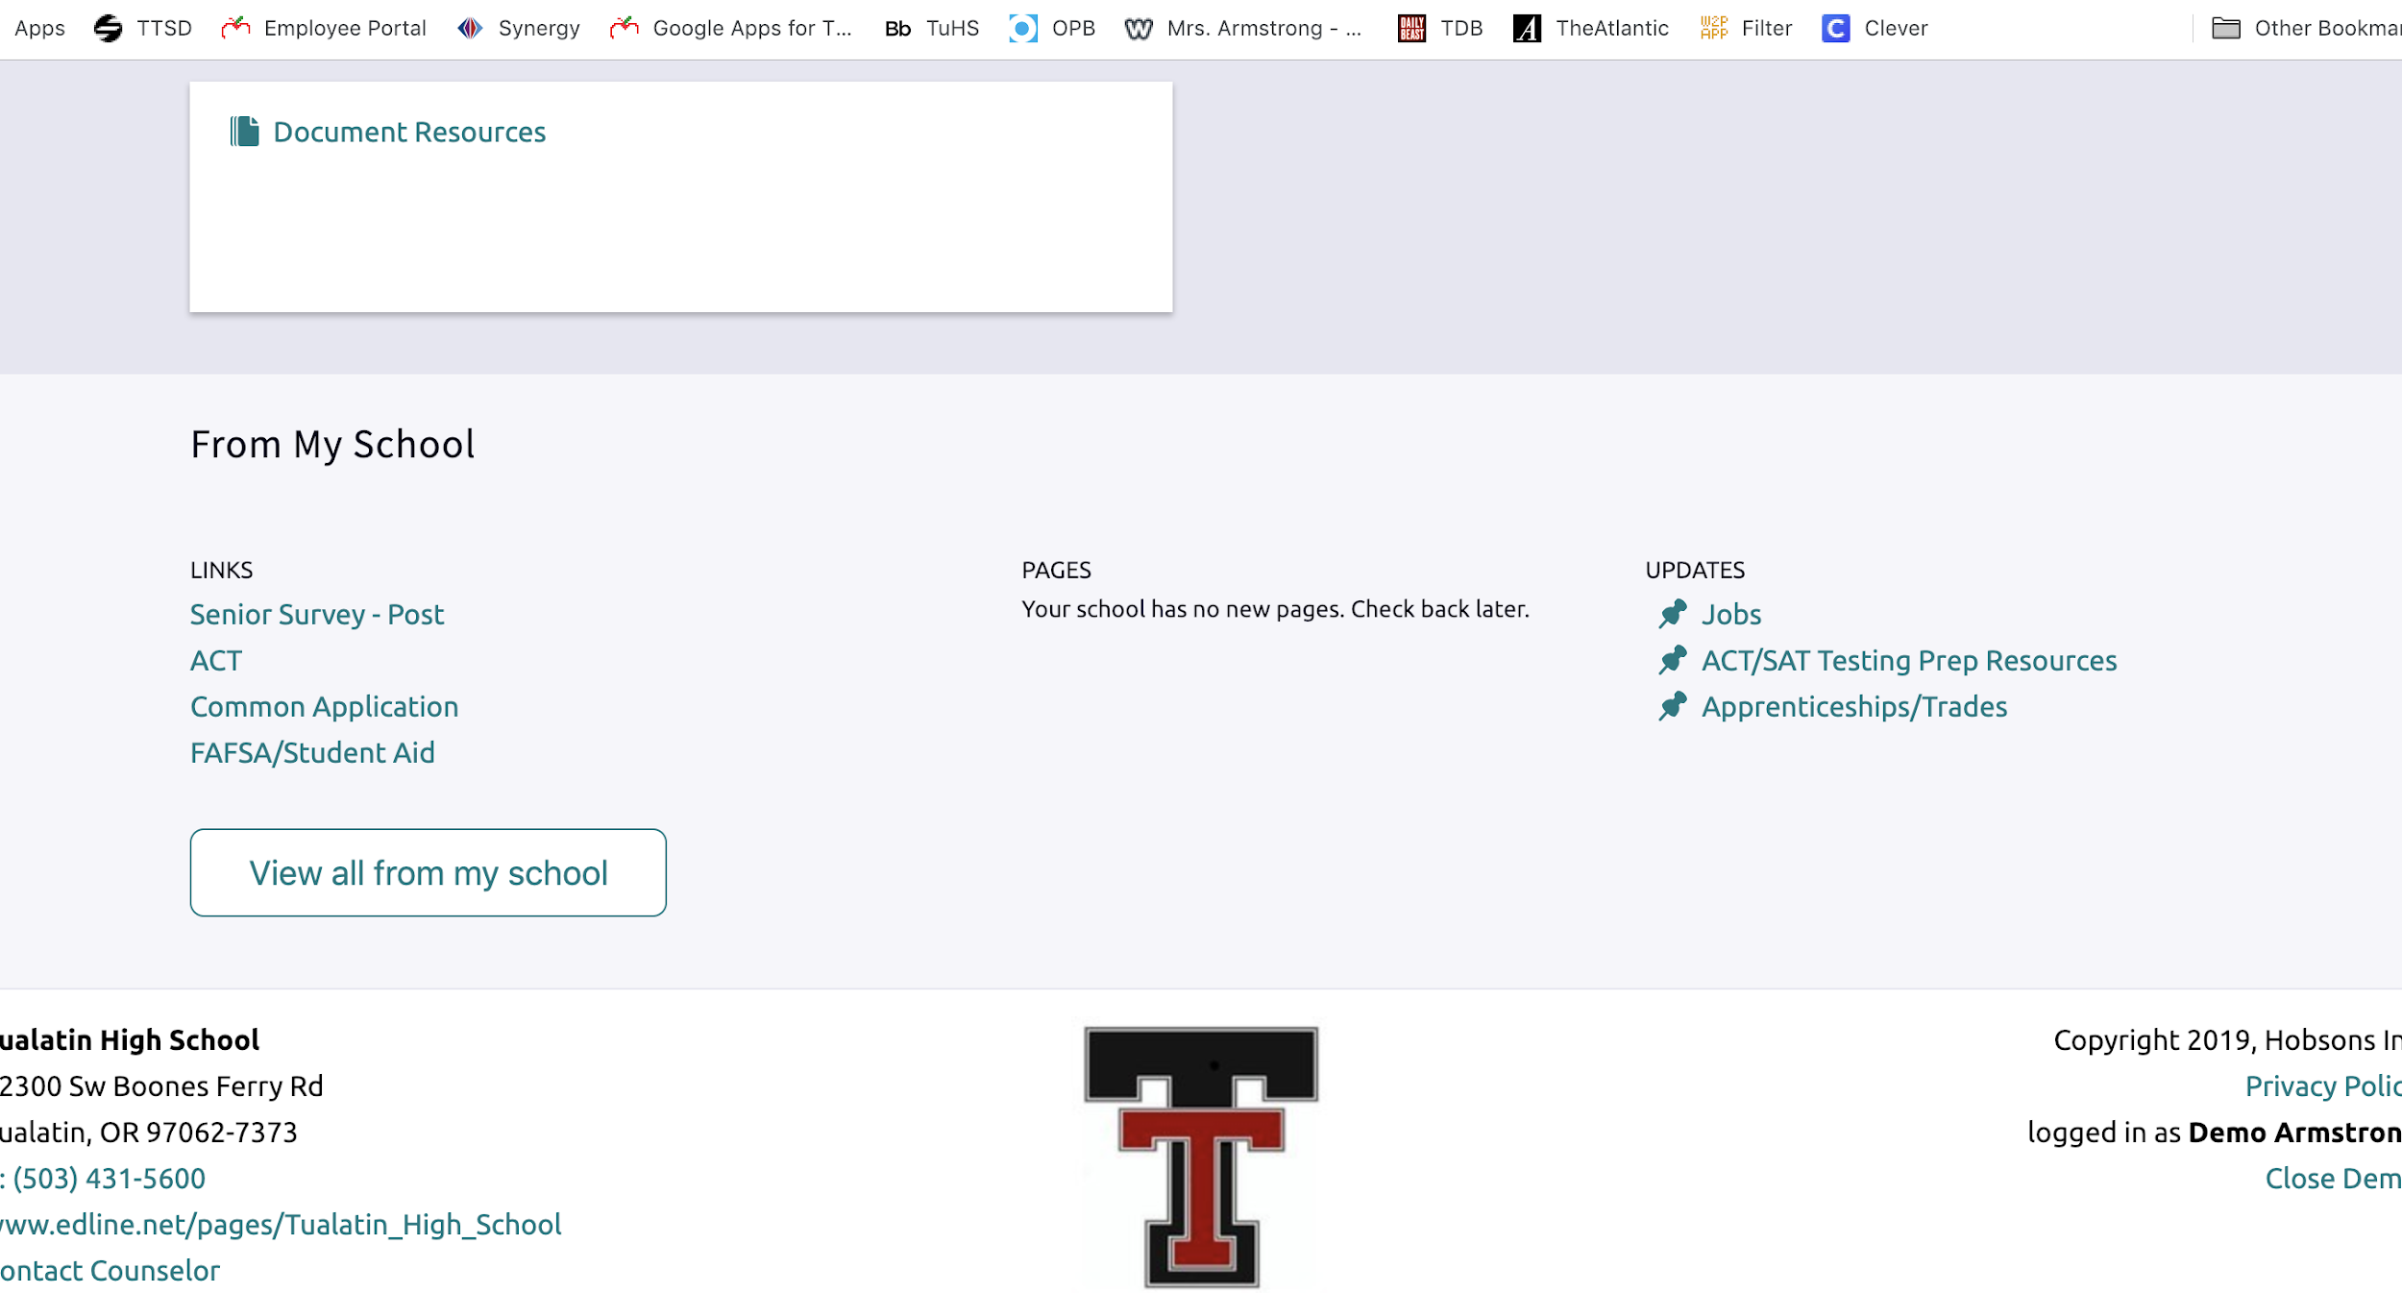
Looking for Volunteer Opportunities

Slide 17
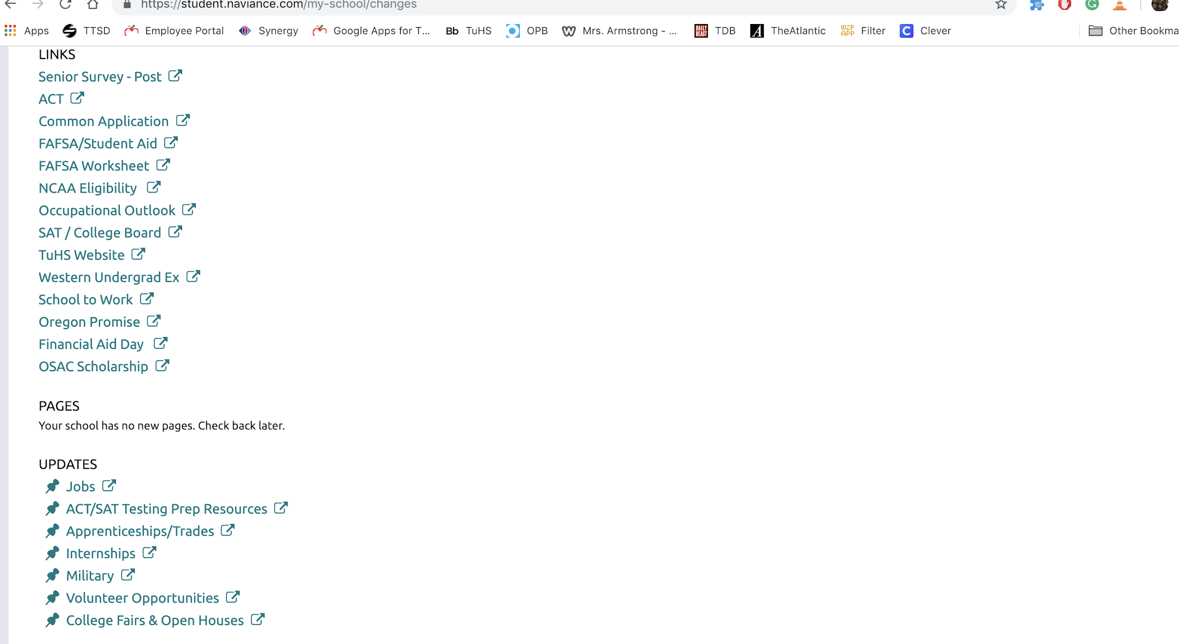
Many (not all - double check with schools you’re interested in) use the Common Application. It can save you a lot of time and effort.
If you are not thinking that college is the route you want to go, Naviance (and the Career Center) also have information on training for trades. Info about the military is also here.
You can up-to-date volunteer opportunities here.

Slide 18
Where can I get help/more information?

Slide 19
Good News!
The College and Career Center (down in the library) can help you find more specific, personalized information about all of these topics we will be looking at today.
Seriously. They are PAID TO HELP YOU.
They will probably start pulling Juniors out of class soon anyway to have a conversation with you about your future plans.
Your counselor can also help you with some of this - particularly as it relates to your schedule or transcript….do you remember who your counselor is???

