Slide 1
Chinese Civil War Propaganda
Examples to Inspire

Slide 2
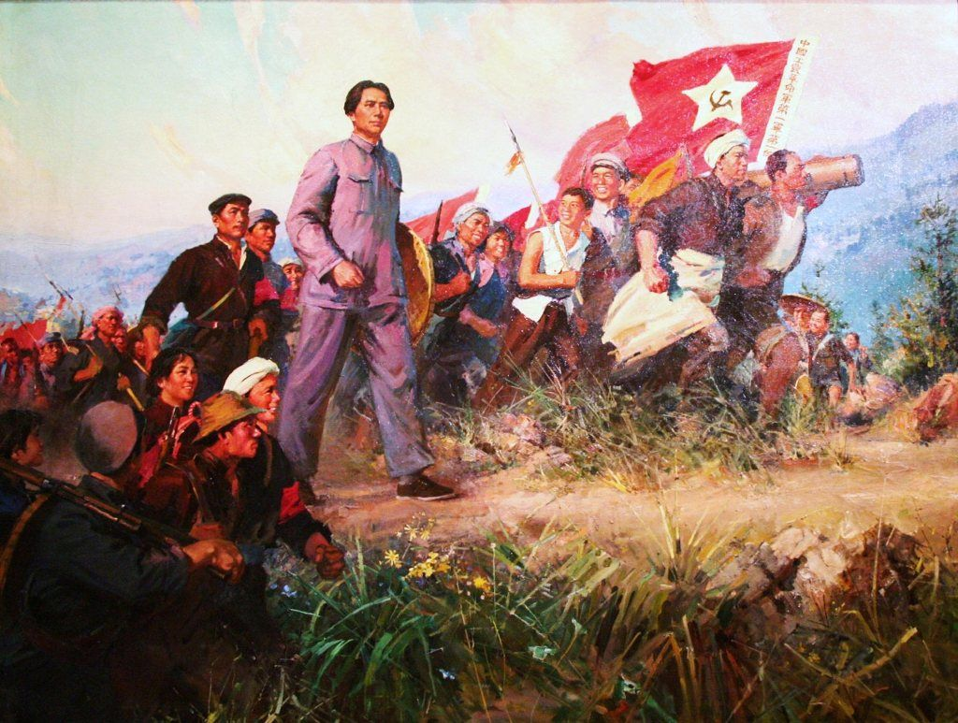

Slide 3
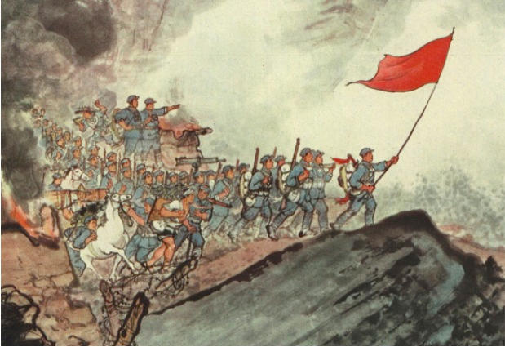

Slide 4
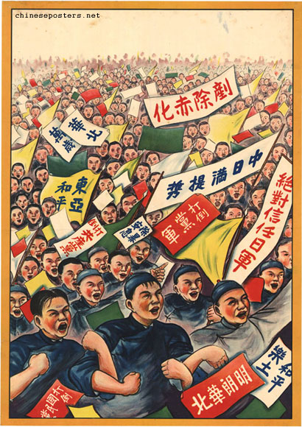

Slide 5
